Slide 1

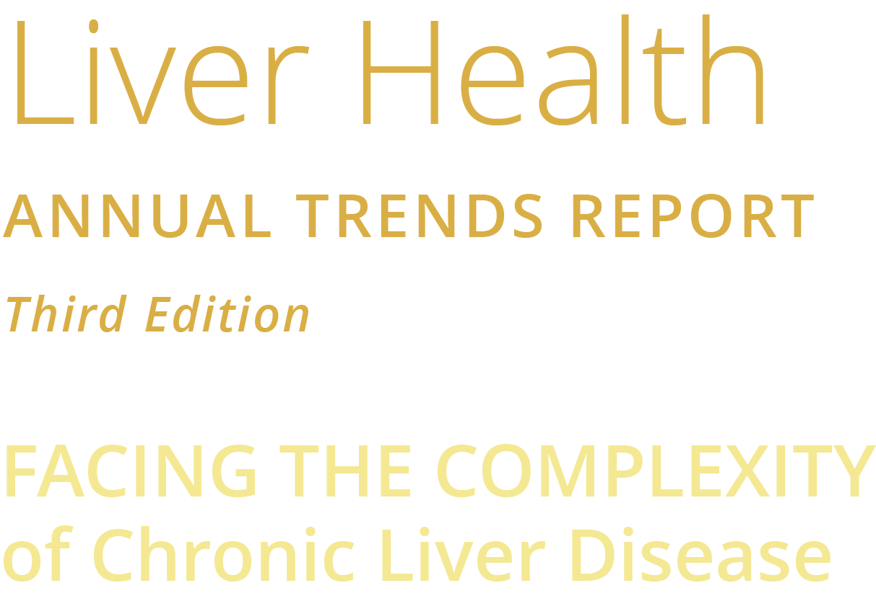

Content contained in this educational disease-state resource is being provided by Salix Pharmaceuticals for informational purposes only. Physicians should use their own clinical judgment in diagnosing, counseling, and advising patients.
Notes:
Welcome to the third edition of the Salix Liver Health Annual Trends Report chart presentation!
Salix Pharmaceuticals, one of the largest specialty pharmaceutical companies in the world committed to gastrointestinal (GI) diseases and disorders, is dedicated to uncovering and addressing the challenges in order to make a positive difference for patients.
This trends report chart presentation is part of that dedication—to understand what barriers exist to quality care for CLD and cirrhosis patients, including those with cirrhotic complications such as hepatic encephalopathy; to measure the trends impacting the adoption of guidelines and improved care over time; and to spread awareness of the challenges.
Content contained in this educational disease-state resource is being provided by Salix Pharmaceuticals for informational purposes only. Physicians should use their own clinical judgment in diagnosing, counseling, and advising patients.

Slide 2
Figures Index
# | Figure Title | Page Number
1 | Types of Liver Disease Participants Treat | 5
2 | Average Number of Liver Disease Patients Seen Monthly | 6
3 | Respondent Time Spent Doing Work-related Tasks | 7
4 | Changes Observed in Liver Disease Incidence Versus Pre-pandemic Levels | 8
5 | Changes Observed in Liver Disease–related Factors Versus Pre-pandemic Levels | 9
6 | Most Important Social/Economic Factors Impacting CLD Patient Outcomes | 11
7 | Provider Roles With the Greatest Impact on Liver Disease Patient Care | 12
8 | Factors Impacting Patient Access to Liver Disease Specialists | 13
9 | Average Wait Time to See a Liver Disease Specialist | 14
10 | Percent of Patients Eligible for and/or Receiving Multidisciplinary Care | 15
11 | Factors That Most Frequently Impede Patients From Receiving Multidisciplinary Care | 16
12 | Percent of Multidisciplinary Care Partners Sharing the Same EHR System | 17
13 | Importance of Care Management on Liver Disease Patient Outcomes | 18
14 | Most Important Factors Considered When Making Treatment Decisions | 19
15 | Respondent Awareness of National Guidelines for Liver Disease Management | 20
16 | Importance of Aligning With National Treatment Guidelines and Quality Measures for CLD | 21
17 | How National Guidelines Are Incorporated Into Care Management | 22
18 | Factors Important in Driving Provider Utilization of Guidelines | 23
19 | Organizations Who Have Written Guidance and/or Quality Measures for Liver Diseases | 24
20 | Utilization of the APRI Score to Identify NASH/NAFLD and Disease Progression | 25
21 | Respondent Agreement With the Following Statements per NAFLD Patient Management | 26
Notes:
[Read slide.]

Slide 3
Figures Index (cont’d)
# | Figure Title | Page Number
22 | Provider Management Focus for Cirrhotic Patients | 27
23 | Provider Management for Hepatic Encephalopathy (Grade I to IV) | 28
24 | Factors Important in Determining Decision to Get a Referral or Consult for OHE | 29
25 | Factors That Most Commonly Limit Duration of Treatment for the Prevention of OHE Recurrence | 30
26 | Most Common Precipitating Factors in Newly Diagnosed OHE Patients | 31
27 | Providers’ Adoption of Dedicated ICD-10 Code (K76.82) for the Treatment of Hepatic Encephalopathy | 32
28 | Provider Types Liver Disease Patients Most Commonly See Post Hospital Discharge | 33
29 | Cost-related Barriers Patients Face When Filling Prescriptions Post-discharge | 34
30 | Providers’ Perceptions on Ideal Provider to Manage Early-stage Liver Disease | 35
31 | Providers’ Perceptions on Ideal Provider to Manage Advanced Liver Disease | 36
32 | Self-reported Proficiency in Communicating With Patients | 37
33 | Respondent Agreement on Liver Disease Patients’ Unmet Needs | 38
34 | EHR Information That Supports Chronic Liver Disease Patient Management | 39
35 | Providers’ Preference for Online Resource to Guide Liver Disease Management | 40
36 | Resources That Support Liver Disease Patient Management | 41
37 | Ancillary Services Available at Urban/Suburban Versus Rural Locations | 42
38 | Types of Pharmacies Used by CLD Patients | 43
39 | Specialty Pharmacy Services That Support Liver Disease Patients | 44
40 | Utilization of Telemedicine—Pre-pandemic Versus Current Utilization | 45
41 | Drivers of Telemedicine Utilization for Routine Patient Visits | 46
Tables Index
# | Table Title | Page Number
1 | Participant Demographics | 4
2 | Projected Liver Disease Demand and Adult Hepatology Workforce Projections, 2018-2033 | 10
Notes:
[Read slide.]

Slide 4
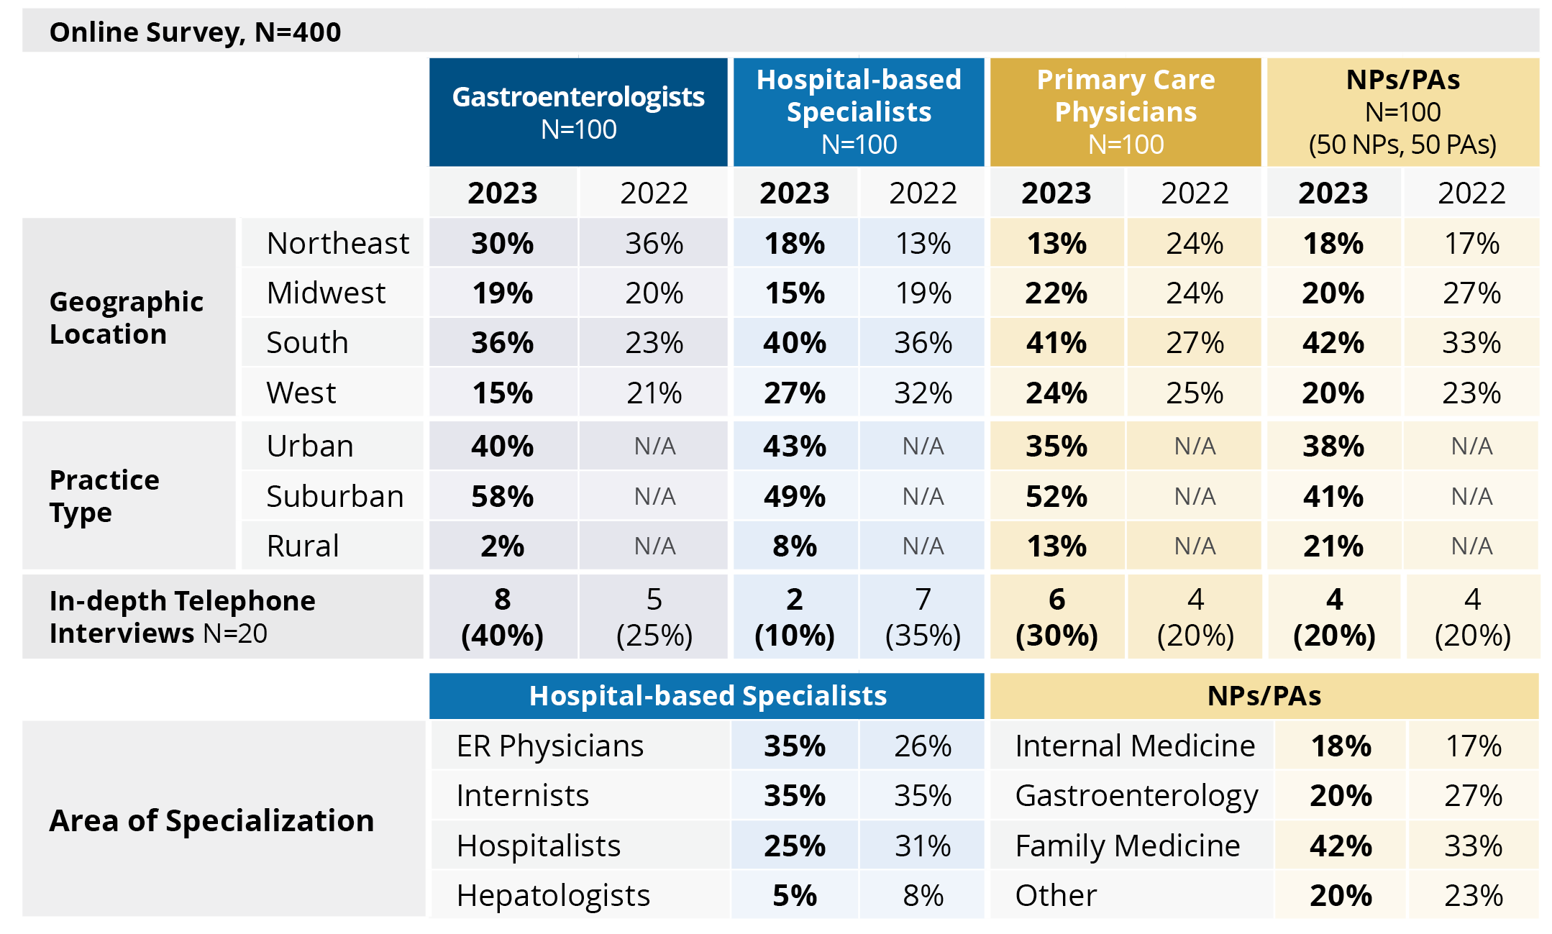
Table 1 | Methodology
Participants Demographics
Notes:
Table 1 | Participants Demographics
Methodology
This trends report on chronic liver disease (CLD) includes information collected from an online survey, qualitative telephone interviews, and secondary research from peer-reviewed publications. An independent third-party recruiting firm invited over 400 health care providers to participate in this research during April and May of 2023. Provider participation (N=400) sought national representation and was comprised of the following subgroups: 100 gastroenterologists, 100 hospital-based specialists, 100 primary care physicians (PCPs), and 100 nurse practitioners/physician assistants (NPs/PAs). Follow-up telephone interviews were conducted with N=20 providers (Table 1). Quotes from the in-depth interviews throughout this report represent the opinions of those respondents. Respondents self-reported on their place of work as being either an urban, suburban, or rural location; and a subgroup analysis was completed to compare findings from respondents. In the urban/suburban group, there were N=356 survey respondents, comprised of the following subgroups: 98 gastroenterologists, 92 hospital-based specialists, 87 PCPs, and 79 NPs/PAs. The rural subgroup was significantly smaller (N=44) and was comprised of 2 gastroenterologists, 8 hospital-based specialists, 13 PCPs, and 21 NPs/PAs.
Limitations of Market Research and Statistical Analysis
Readers should be aware that the market research and statistical analysis in this report were conducted in a manner consistent with industry standards and market research codes of conduct. Market research of this type is based on a random sample and reports on aggregated respondents’ perceptions. This is in no way comparable to the scientific rigor of clinical research. As it pertains to the online survey, analysis was conducted utilizing the QPSMR data analysis software; all statistical significance in this report is at 95% confidence. Several survey questions utilize a Likert scale and top 2 box score reporting methodology. In these questions, respondents are asked to select a response on a 7-point scale that best matches the respondent’s perception (eg, on a scale of 1 to 7, where 1 is not important and 7 is very important). The top 2 box score refers to the percentage of respondents that select a 6 or 7 response from the Likert scale (eg, “important/very important”).
Secondary research was conducted utilizing Google and PubMed searches to identify relevant peer-reviewed publications and sources as noted in the report. Furthermore, treatment utilization and claims data were sourced from IQVIA. Secondary research may not reflect all published data. A systematic review was not performed.

Slide 5
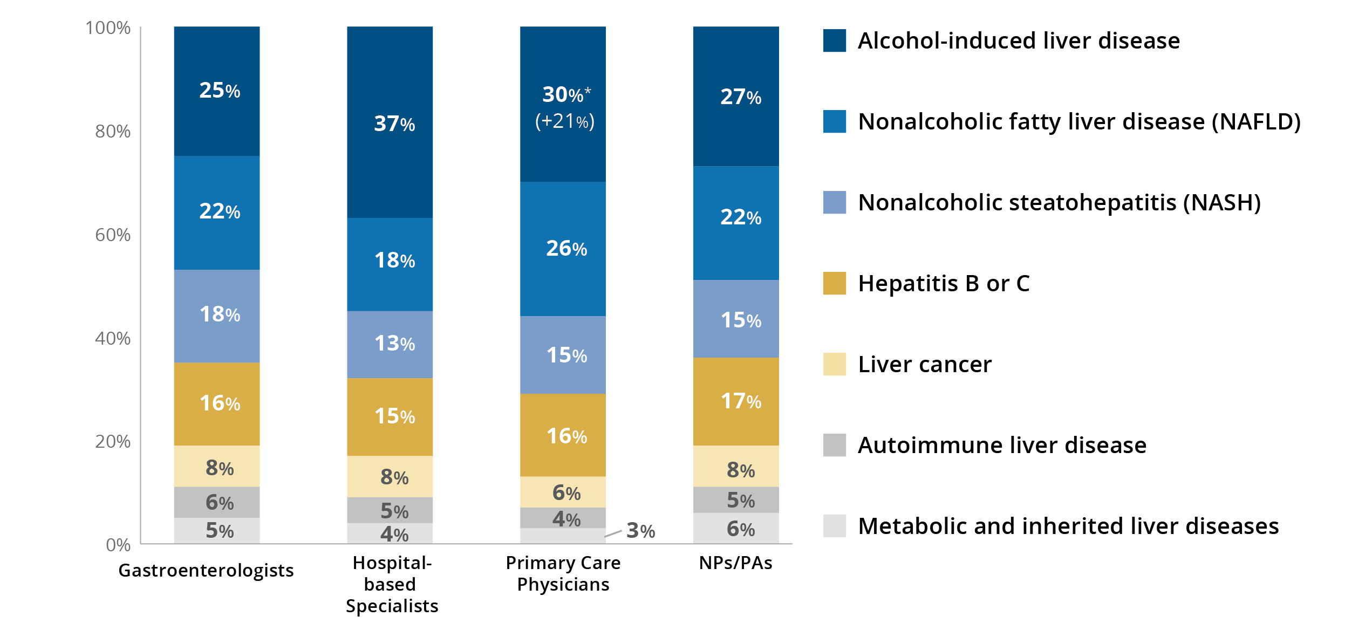
Figure 1 | Methodology | Primary Market Research via Survey
Types of Liver Disease Participants Treat
Q2. What percentage of the chronic liver disease patient population that you treat have the following conditions (total must equal 100%)?
N=400 (100 Gastroenterologists, 100 Hospital-based Specialists, 100 PCPs, 100 NP/PAs).
*This number is statistically significant at 95% confidence versus last year.
Values in parentheses indicate percent change from 2022.
Notes:
Figure 1 | Types of Liver Disease Participants Treat
[Read slide.]

Slide 6
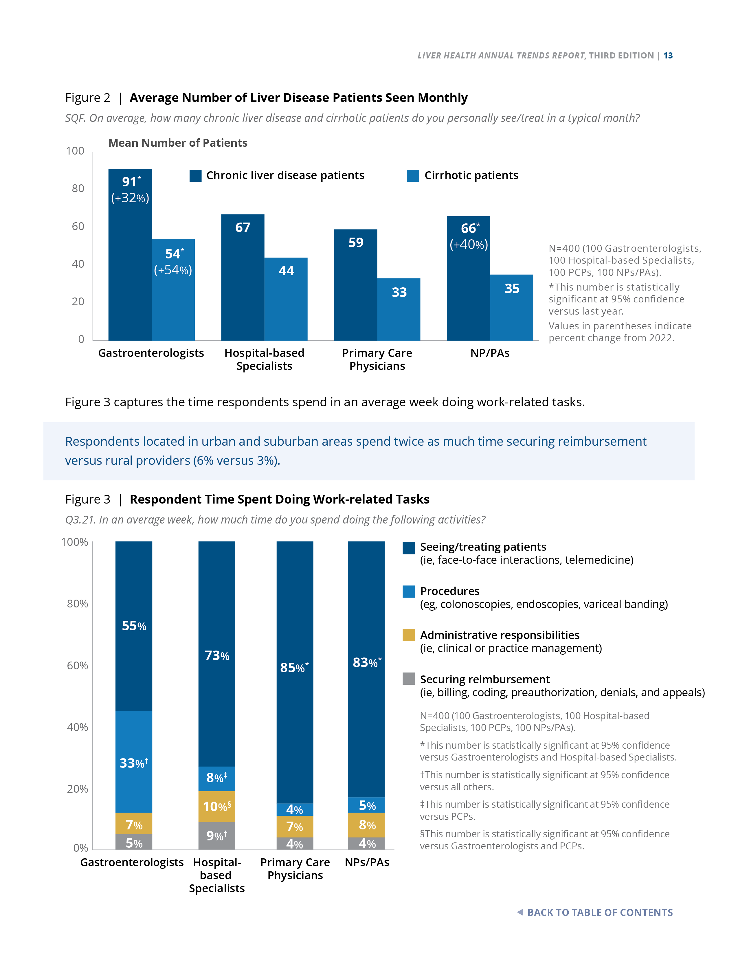
Figure 2 | Methodology | Primary Market Research via Survey
Average Number of Liver Disease Patients Seen Monthly
SQF. On average, how many chronic liver disease and cirrhotic patients do you personally see/treat in a typical month?
N=400 (100 Gastroenterologists, 100 Hospital-based Specialists, 100 PCPs, 100 NPs/PAs).
*This number is statistically significant at 95% confidence versus last year.
Values in parentheses indicate percent change from 2022.
Notes:
Figure 2 | Average Number of Liver Disease Patients Seen Monthly
Primary Market Research via Survey
Gastroenterologists are seeing statistically significant more patients per month versus last year (eg, 91 patients with CLD per month [+32%] and 54 patients with cirrhosis per month [+54%]).

Slide 7
Figure 3 | Methodology | Primary Market Research via Survey
Respondent Time Spent Doing Work-related Tasks
Q3.21. In an average week, how much time do you spend doing the following activities?
Respondents located in urban and suburban areas spend twice as much time securing reimbursement versus rural providers (6% versus 3%).
N=400 (100 Gastroenterologists, 100 Hospital-based Specialists, 100 PCPs, 100 NPs/PAs).
*This number is statistically significant at 95% confidence versus Gastroenterologists and Hospital-based Specialists.
†This number is statistically significant at 95% confidence versus all others.
‡This number is statistically significant at 95% confidence versus PCPs.
§This number is statistically significant at 95% confidence versus Gastroenterologists and PCPs.
Notes:
Figure 3 | Respondent Time Spent Doing Work-related Tasks
Primary Market Research via Survey
Figure 3 captures the time respondents spend in an average week doing work-related tasks.
Respondents located in urban and suburban areas spend twice as much time securing reimbursement versus rural providers (6% versus 3%).

Slide 8
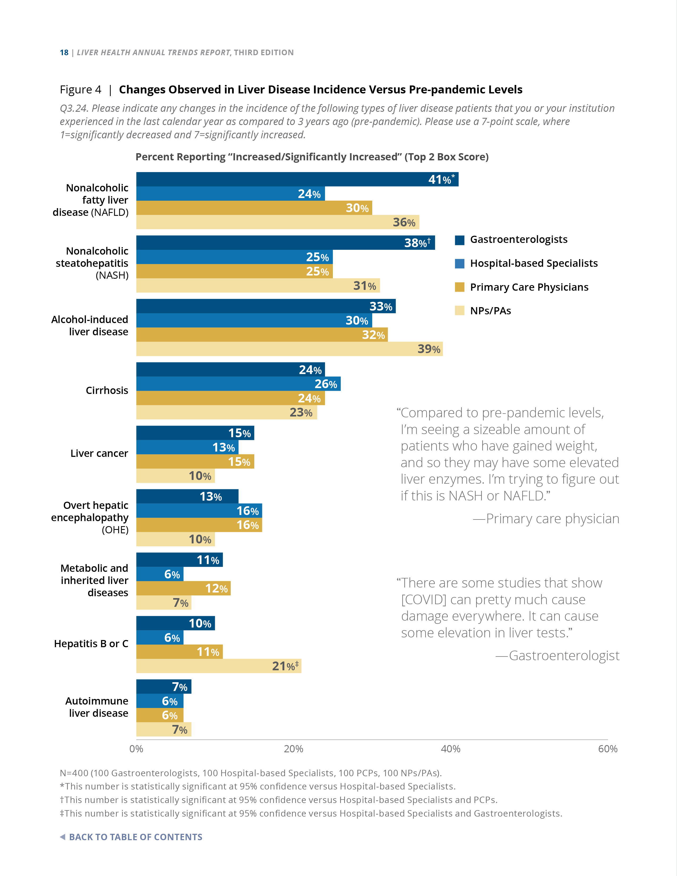
Figure 4 | Burden of Illness | Primary Market Research via Survey
Changes Observed in Liver Disease Incidence Versus Pre-pandemic Levels
Q3.24. Please indicate any changes in the incidence of the following types of liver disease patients that you or your institution experienced in the last calendar year as compared to 3 years ago (pre-pandemic). Please use a 7-point scale, where 1=significantly decreased and 7=significantly increased.
In the last calendar year, as compared to pre-pandemic levels, 41% of gastroenterologists saw an increase in nonalcoholic fatty liver disease (NAFLD), 38% reported increases in nonalcoholic steatohepatitis (NASH), and 33% of gastroenterologists saw an increase in alcohol-associated liver disease (ALD). Similar increases were reported by NPs/PAs.
N=400 (100 Gastroenterologists, 100 Hospital-based Specialists, 100 PCPs,
100 NPs/PAs).
*This number is statistically significant at 95% confidence versus Hospital-based Specialists.
†This number is statistically significant at 95% confidence versus Hospital-based Specialists and PCPs.
‡This number is statistically significant at 95% confidence versus Hospital-based Specialists and Gastroenterologists.
Notes:
Figure 4 | Changes Observed in Liver Disease Incidence Versus Pre-pandemic Levels
Primary Market Research via Survey
In the last calendar year, as compared to pre-pandemic levels, 41% of gastroenterologists saw an increase in nonalcoholic fatty liver disease (NAFLD), 38% reported increases in nonalcoholic steatohepatitis (NASH), and 33% of gastroenterologists saw an increase in alcohol-associated liver disease (ALD). Similar increases were reported by NPs/PAs.

Slide 9
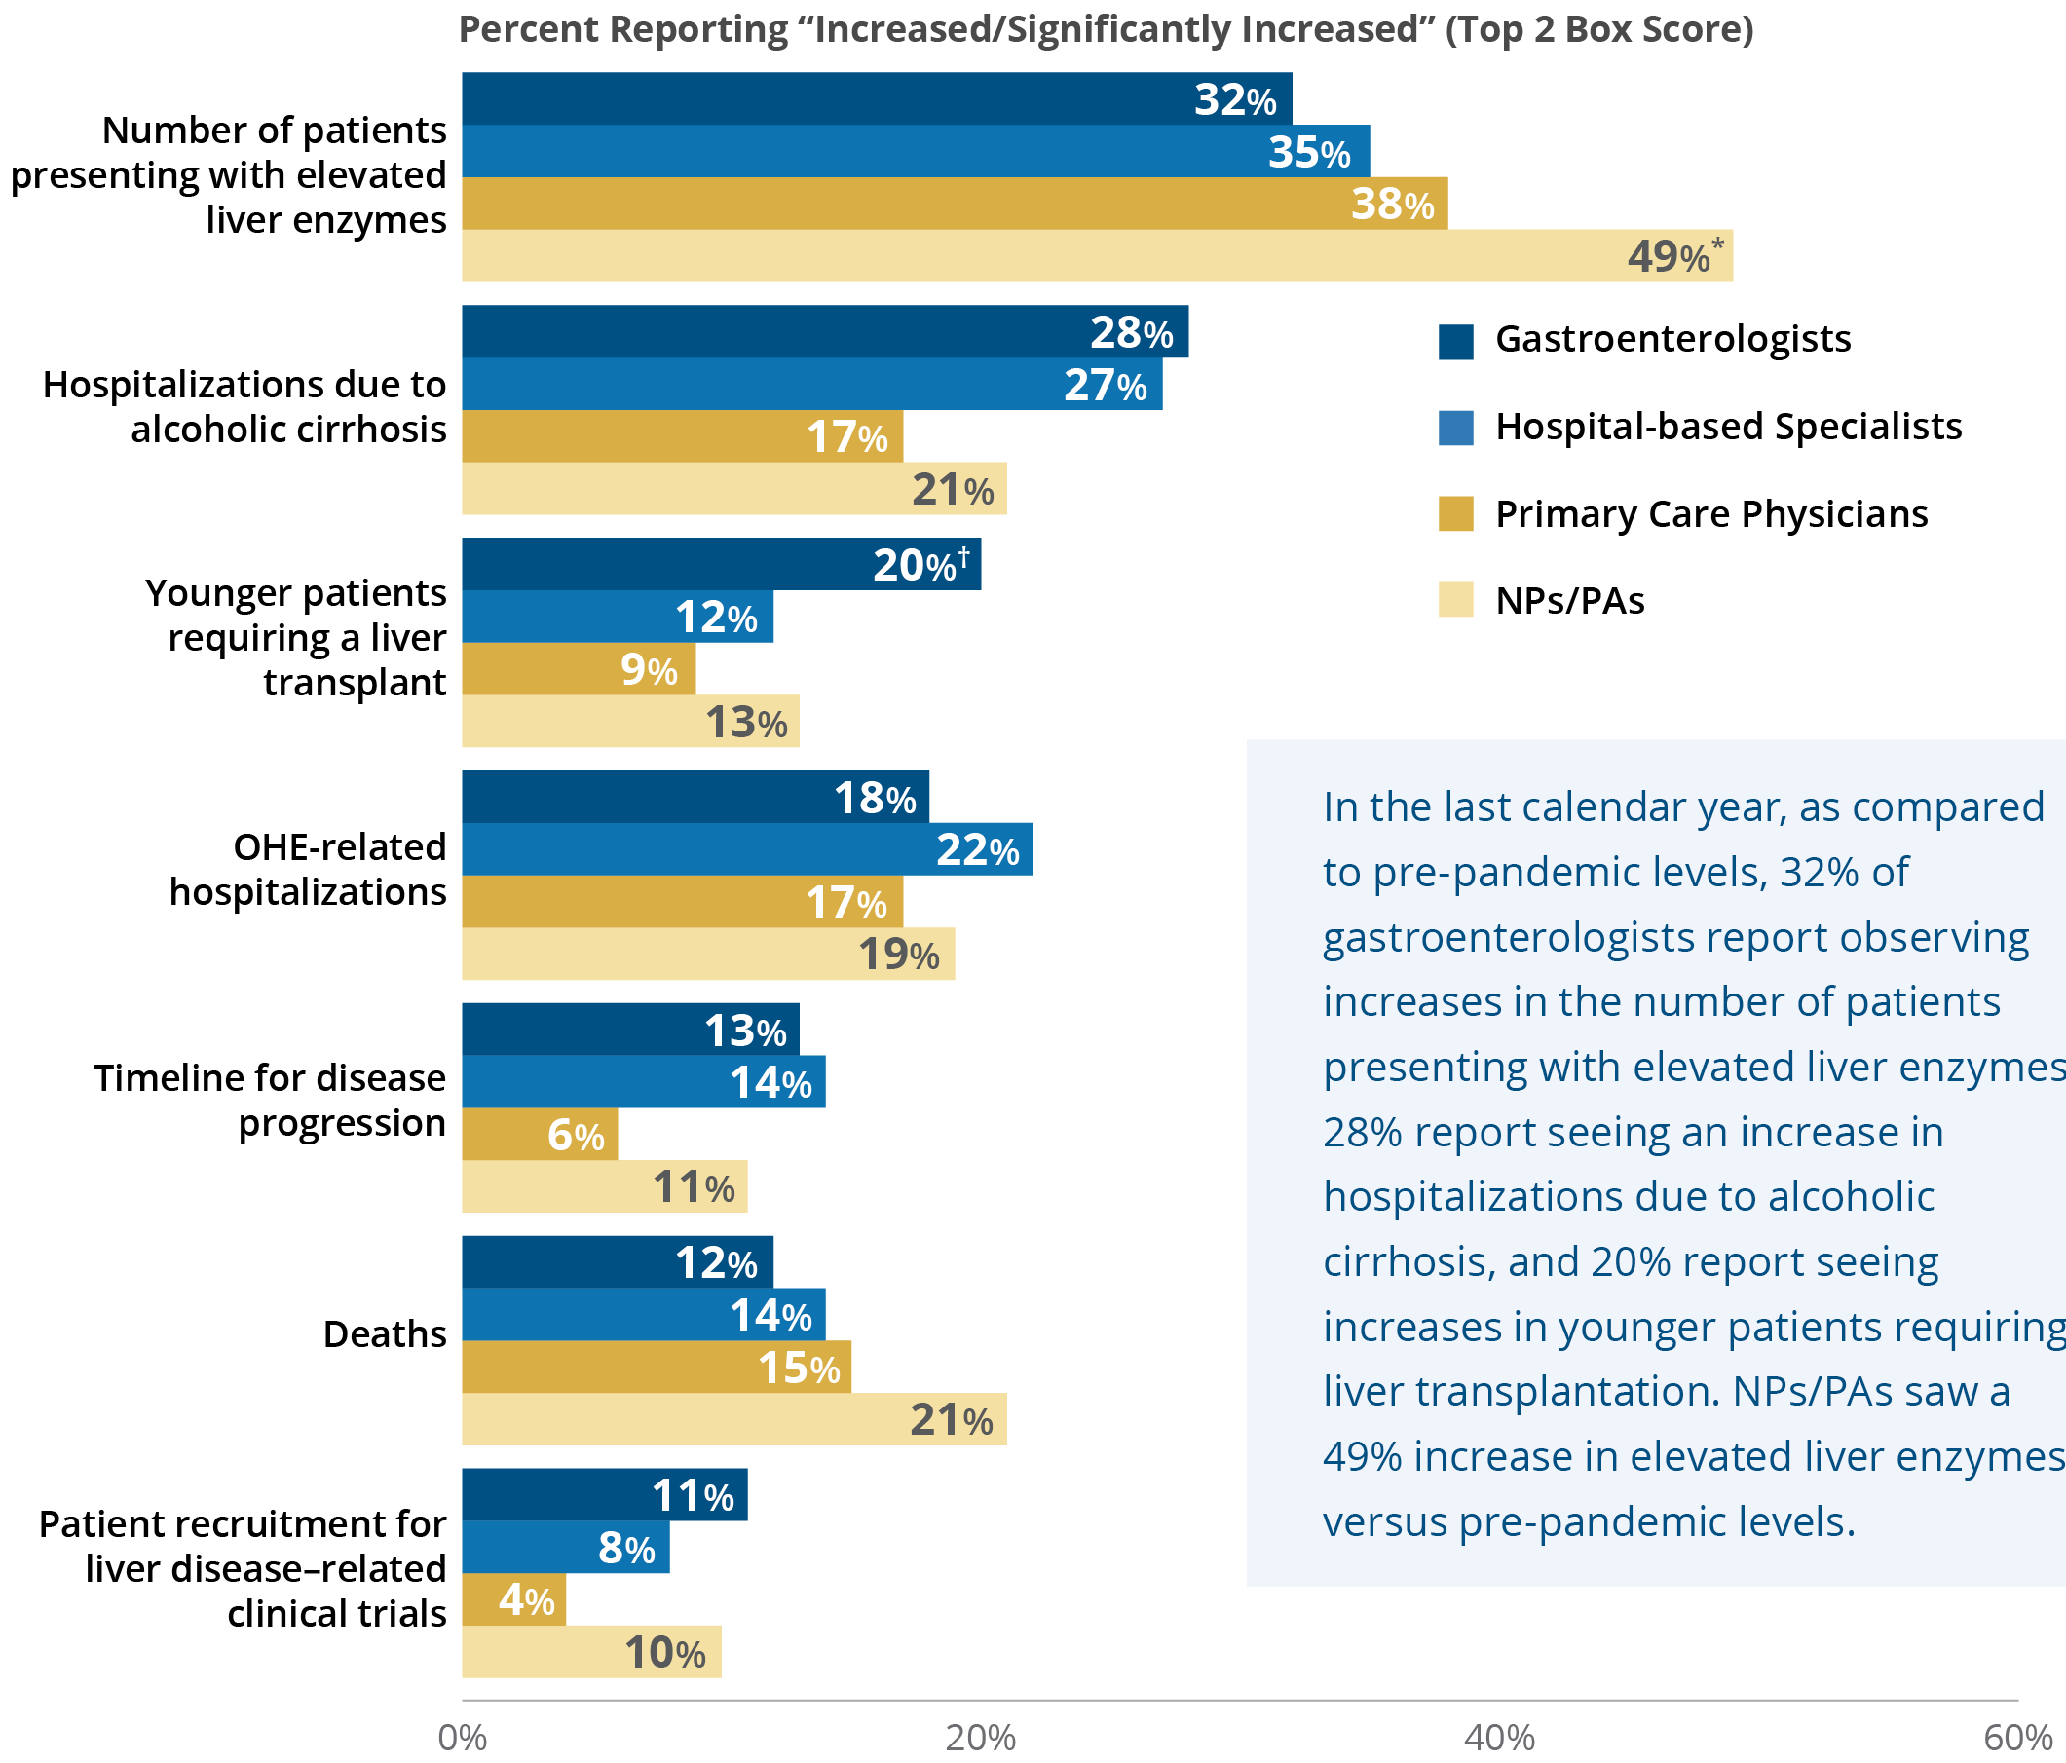
Figure 5 | Burden of Illness | Primary Market Research via Survey
Changes Observed in Liver Disease–related Factors Versus Pre-pandemic Levels
Q3.25. Please indicate any changes that you or your institution experienced as it pertains to your adult liver disease patients in the last calendar year as compared to 3 years ago (pre-pandemic). Please use a 7-point scale, where 1=significantly decreased and 7=significantly increased.
In the last calendar year, as compared to pre-pandemic levels, 32% of gastroenterologists report observing increases in the number of patients presenting with elevated liver enzymes, 28% report seeing an increase in hospitalizations due to alcoholic cirrhosis, and 20% report seeing increases in younger patients requiring liver transplantation. NPs/PAs saw a 49% increase in elevated liver enzymes versus pre-pandemic levels.
N=400 (100 Gastroenterologists, 100 Hospital-based Specialists, 100 PCPs,
100 NPs/PAs).
*This number is statistically significant at 95% confidence versus Gastroenterologists and Hospital-based Specialists.
†This number is statistically significant at 95% confidence versus PCPs.
Notes:
Figure 5 | Changes Observed in Liver Disease–related Factors Versus Pre-pandemic Levels
Primary Market Research via Survey
In the last calendar year, as compared to pre-pandemic levels, 32% of gastroenterologists report observing increases in the number of patients presenting with elevated liver enzymes, 28% report seeing an increase in hospitalizations due to alcoholic cirrhosis, and 20% report seeing increases in younger patients requiring liver transplantation. NPs/PAs saw a 49% increase in elevated liver enzymes versus pre-pandemic levels.

Slide 10
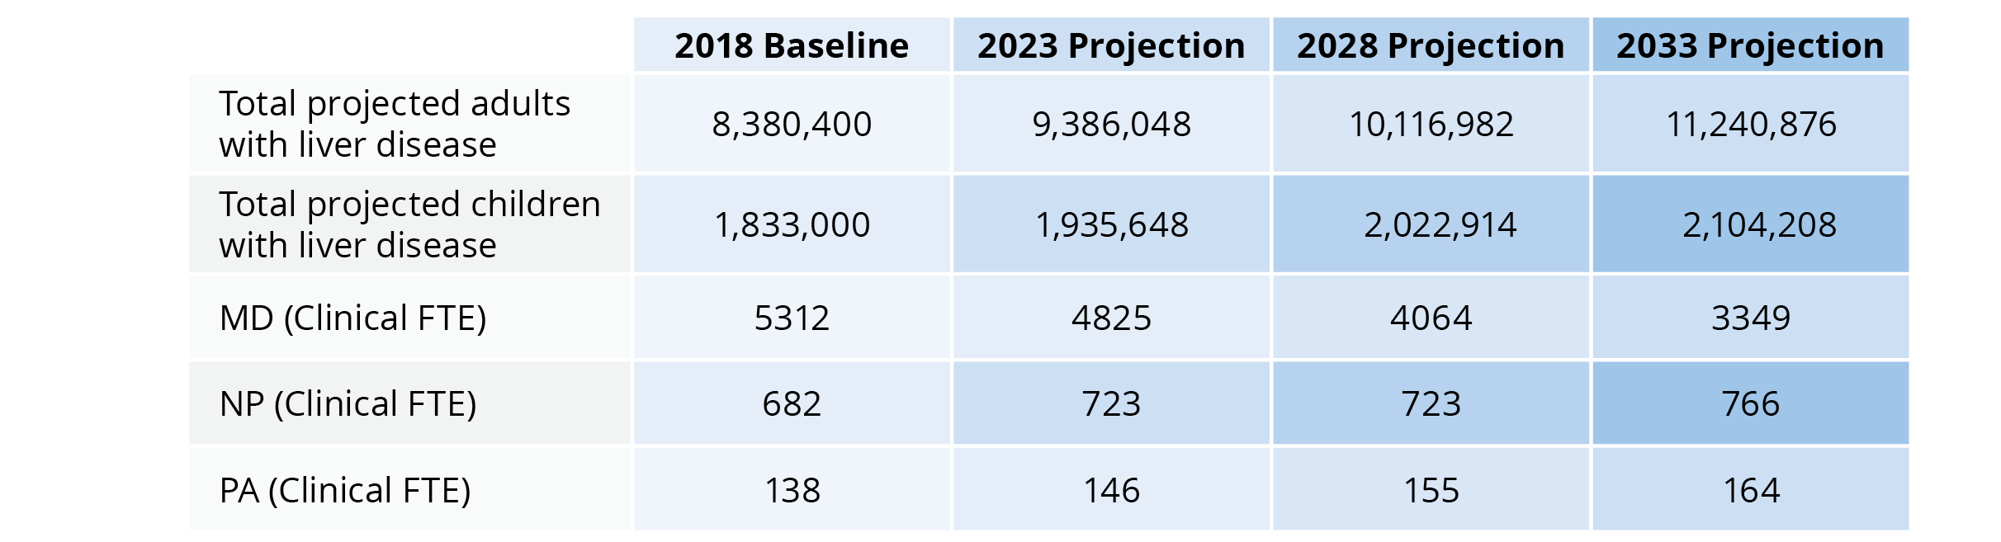
Table 2 | Disparities in Care | Secondary Research From Peer-reviewed Publications
Projected Liver Disease Demand and Adult Hepatology Workforce Projections, 2018-2033¹
The shift in care of patients with liver disease may fall not only to transplant hepatologists but also to advanced practice providers (APPs) or other clinicians, such as primary care providers.¹
FTE=full-time equivalent; MD=hepatologist or gastroenterologist who practices 50% or more hepatology; NP=nurse practitioner; PA=physician assistant.
Reference: 1. Russo MW, Fix OK, Koteish AA, et al. Modeling the hepatology workforce in the United States: a predicted critical shortage. Hepatology. 2020;72(4):1444-1454.
Notes:
Table 2 | Projected Liver Disease Demand and Adult Hepatology Workforce Projections, 2018-2033
Secondary Research
A 2018 predictive model from the American Association for the Study of Liver Diseases (AASLD) workforce study group reported a critical shortage of hepatology providers. They identified about 8000 gastroenterologists, hepatologists, and advanced practice providers (APPs) who had practices in which at least half of their time was spent in hepatology.¹ The modeling analysis predicts shortages in 2023, 2028, and 2033 of 10%, 23%, and 35% clinical full-time employees, respectively, in adult hepatology.¹
Reference: 1. Russo MW, Fix OK, Koteish AA, et al. Modeling the hepatology workforce in the United States: a predicted critical shortage. Hepatology. 2020;72(4):1444-1454.

Slide 11
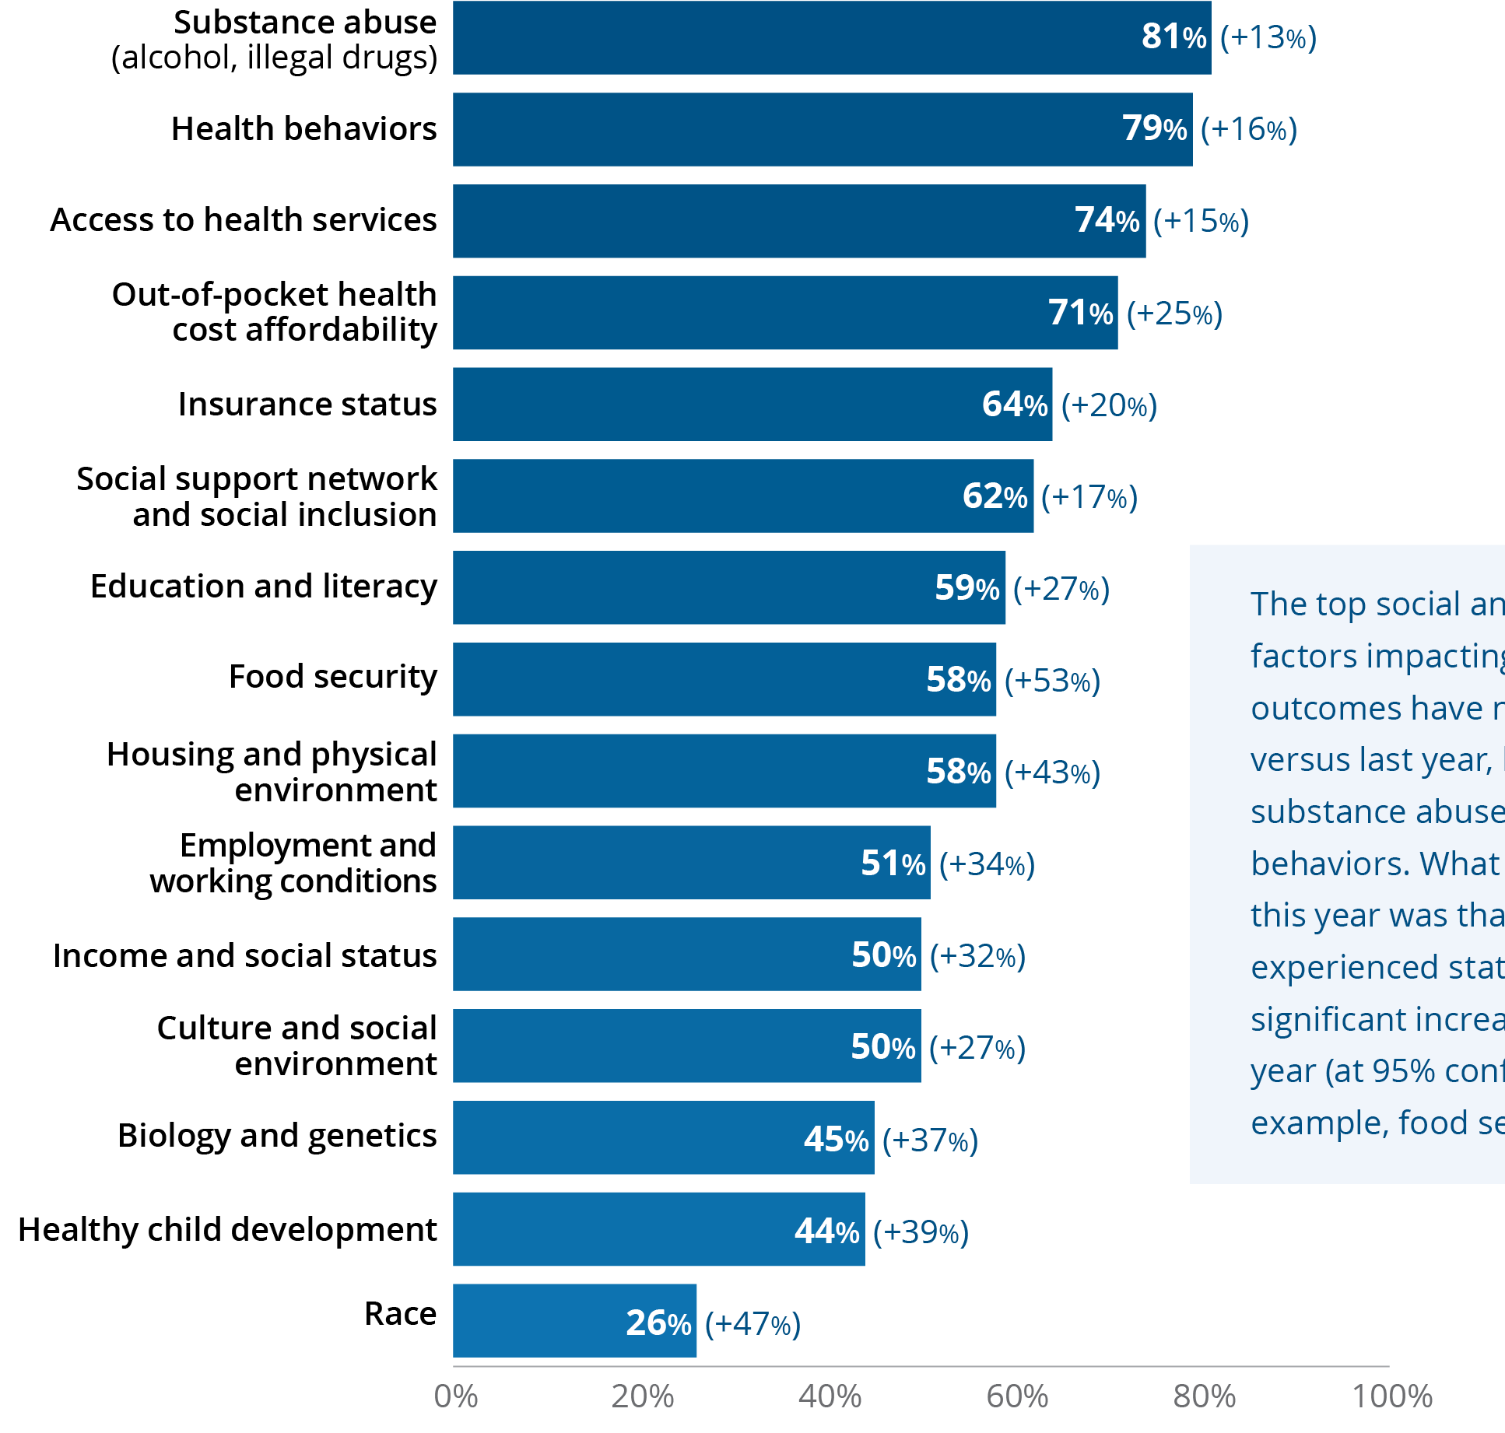
Figure 6 | Burden of Illness | Primary Market Research via Survey
Most Important Social/Economic Factors
Impacting CLD Patient Outcomes
Percent Reporting “Important/Very Important” (Top 2 Box Score)
Q1. In your patient population, please rate the importance of the following social or economic factors on the health outcomes of your chronic liver disease patient population. Please use a 7-point scale, where 1=not at all important and 7=very important.
The top social and economic factors impacting CLD patient outcomes have not changed versus last year, leading with substance abuse and health behaviors. What was remarkable this year was that every factor experienced statistically significant increases versus last year (at 95% confidence). For example, food security rose 53%.
N=400 (100 Gastroenterologists, 100 Hospital-based Specialists, 100 PCPs, 100 NPs/PAs).
*All of the data points are statistically significant at 95% confidence versus last year.
Values in parentheses indicate percent change from 2022.
Notes:
Figure 6 | Most Important Social/Economic Factors Impacting CLD Patient Outcomes
Primary Market Research via Survey
This year, all socioeconomic factors impacting liver disease patient outcomes experienced statistically significant increases in their importance ratings as compared to 2022 (at 95% confidence). For example, food security rose 53%.

Slide 12
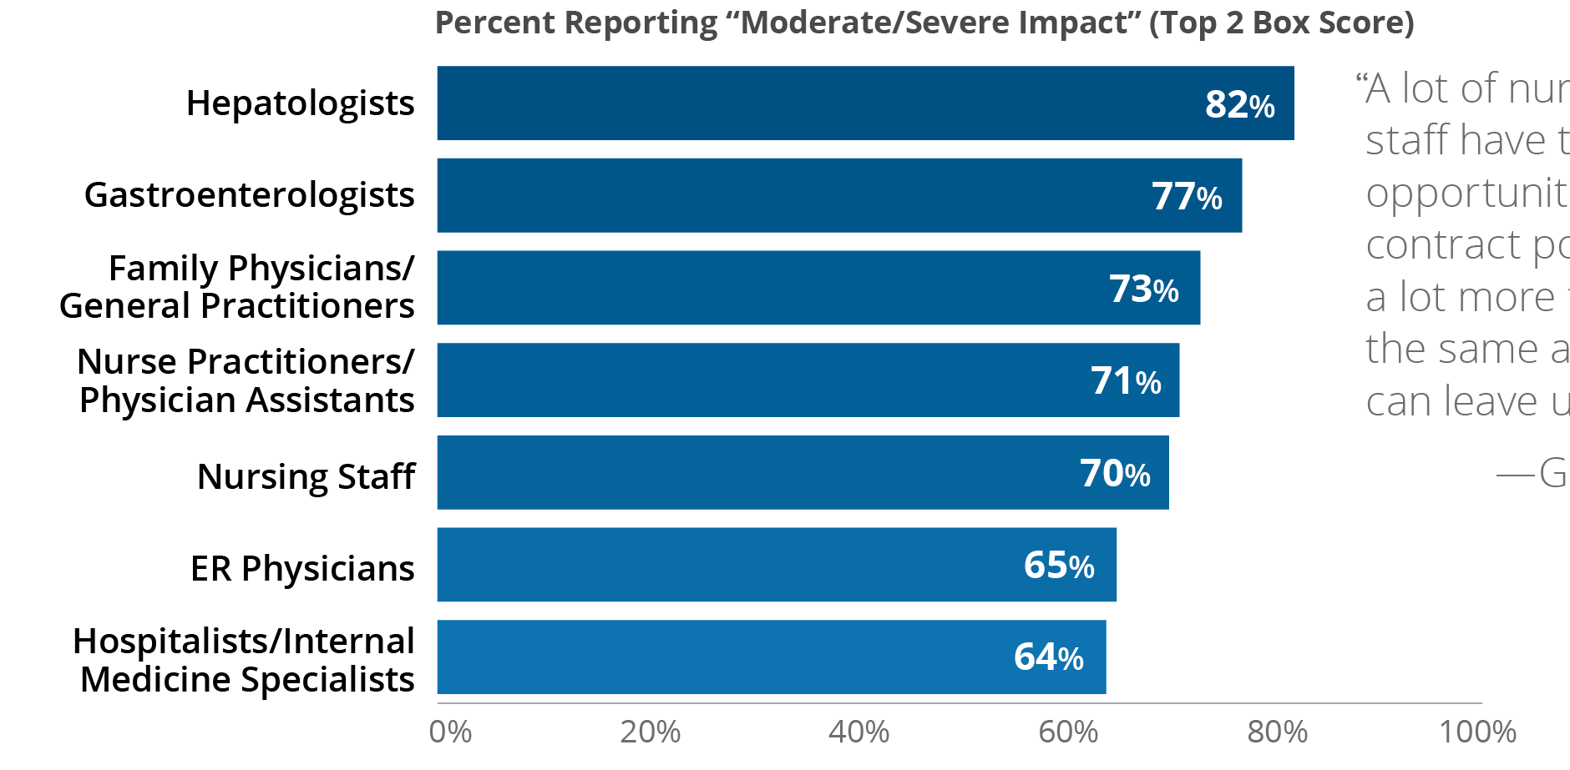
Figure 7 | Disparities in Care | Primary Market Research via Survey
Provider Roles With the Greatest Impact on Liver Disease Patient Care
Q3.13. In what roles have the greatest shortages occurred? To what degree, if any, have these shortages impacted your organization’s ability to manage patients living with liver disease? Please use a 5-point scale, where 1=no impact at all and 5=severe impact.
Overall, 72% of all respondents report that their organizations have suffered chronic staffing shortages across many roles.
Eighty percent of respondents report chronic nursing shortages. A lesser 29% report shortages of gastroenterologists, and 26% report shortages of hepatologists.
Respondents report that shortages in hepatologists and gastroenterologists have the greatest impact on their organization’s ability to manage liver disease patient care (82% and 77%, respectively).
Respondents working in rural settings reported 43% higher shortages of PCPs versus respondents working in an urban/suburban setting at 28% (at 95% confidence).
N=400 (100 Gastroenterologists, 100 Hospital-based Specialists, 100 PCPs, 100 NPs/PAs).
Notes:
Figure 7 | Provider Roles With the Greatest Impact on Liver Disease Patient Care
Primary Market Research via Survey
Overall, 72% of all respondents report that their organizations have suffered chronic staffing shortages across many roles.
Eighty percent of respondents reported chronic nursing shortages within their organizations. A lesser 29% report shortages of gastroenterologists, and 26% report shortages of hepatologists.
Respondents report that shortages in hepatologists and gastroenterologists have the greatest impact on their organization’s ability to manage liver disease patient care (82% and 77%, respectively).
Respondents working in rural settings reported 43% higher shortages of PCPs versus respondents working in an urban/suburban setting at 28% (at 95% confidence).

Slide 13
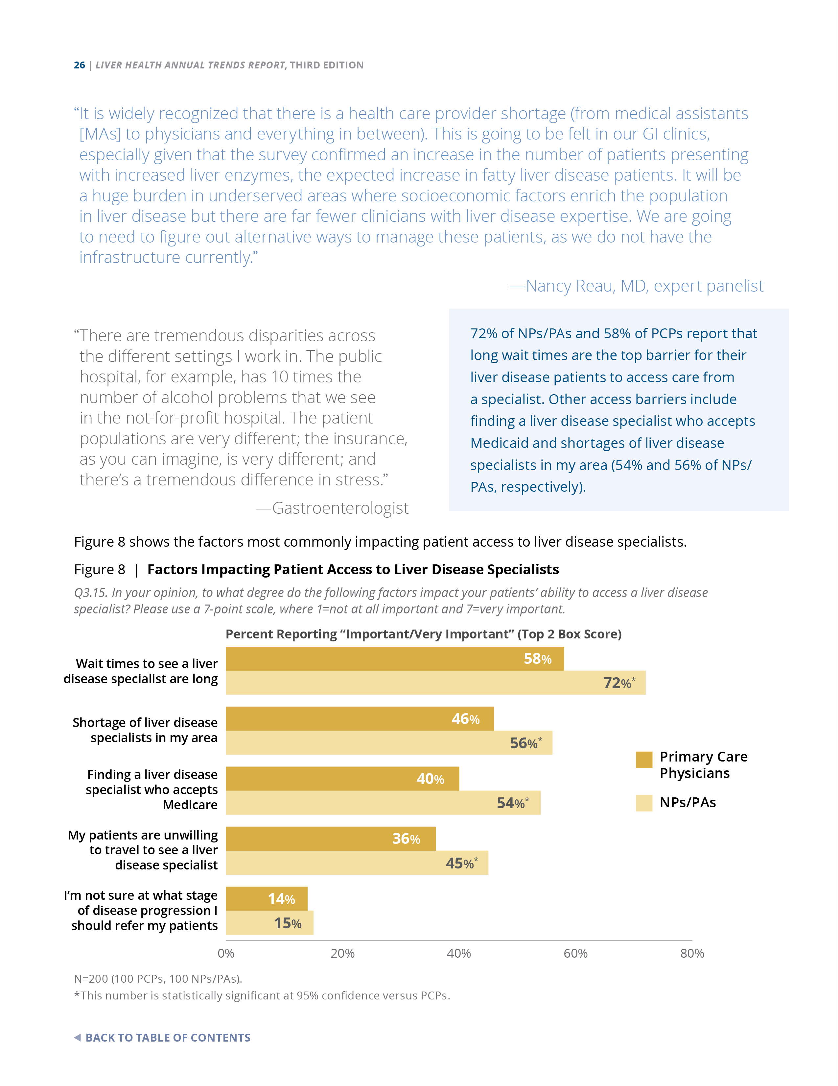
Figure 8 | Disparities in Care | Primary Market Research via Survey
Factors Impacting Patient Access to Liver Disease Specialists
Q3.15. In your opinion, to what degree do the following factors impact your patients’ ability to access a liver disease specialist? Please use a 7-point scale, where 1=not at all important and 7=very important.
N=200 (100 PCPs, 100 NPs/PAs).
*This number is statistically significant at 95% confidence versus PCPs.
72% of NPs/PAs and 58% of PCPs report that long wait times are the top barrier for their liver disease patients to access care from a specialist. Other access barriers include finding a liver disease specialist who accepts Medicaid and shortages of liver disease specialists in my area (54% and 56% of NPs/PAs, respectively).
Notes:
Figure 8 | Factors Impacting Patient Access to Liver Disease Specialists
Primary Market Research via Survey
Seventy-two percent of nurse practitioners/physician assistants (NPs/PAs) and 58% of PCPs report that long wait times are the top barrier for their liver disease patients to access care from a specialist. Other access barriers include finding a liver disease specialist who accepts Medicaid and shortages of liver disease specialists in my area (54% and 56% of NPs/PAs, respectively).

Slide 14
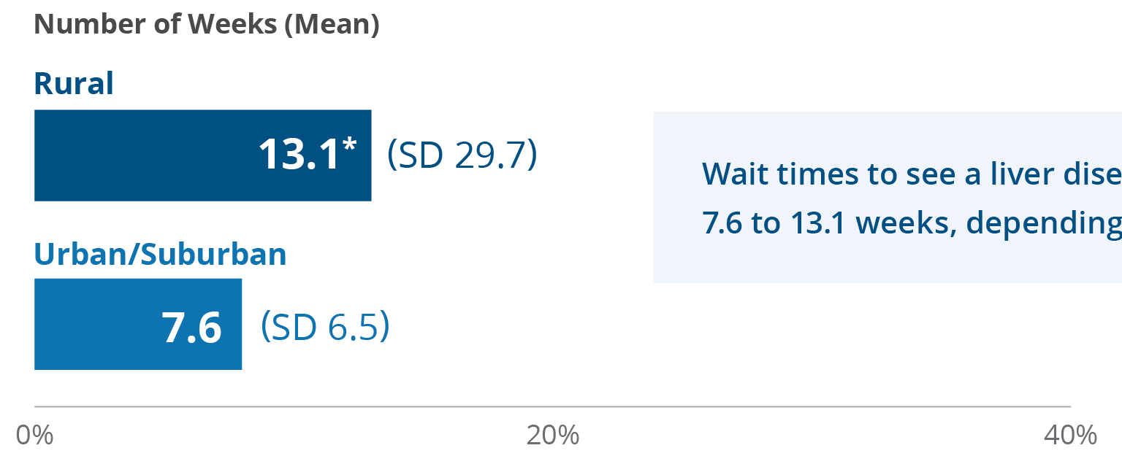
Figure 9 | Disparities in Care | Primary Market Research via Survey
Average Wait Time to See a Liver Disease Specialist
Q3.16. On average, in your practice area, how many weeks does a patient have to wait to get in to see a liver disease specialist?
Wait times to see a liver disease specialist are, on average, 7.6 to 13.1 weeks, depending on where you live.
N=400 (356 urban/suburban providers, 44 rural providers).
*This number is statistically significant at 95% confidence versus urban/suburban providers.
The numbers in parentheses indicate the standard deviation (SD) for these values.
Notes:
Figure 9 | Average Wait Time to See a Liver Disease Specialist
Primary Market Research via Survey
While disparities of care can and do happen in all parts of the country, several issues were amplified in the survey results of those providers working in rural locations. For example, for providers working in rural locations, the average wait time for a patient to see a liver disease specialist was almost double at 13.1 weeks with an SD of 29.7 (indicating a wide range [eg, wait times almost 1 year]) compared with 7.6 weeks (SD 6.5) for urban/suburban locations.

Slide 15
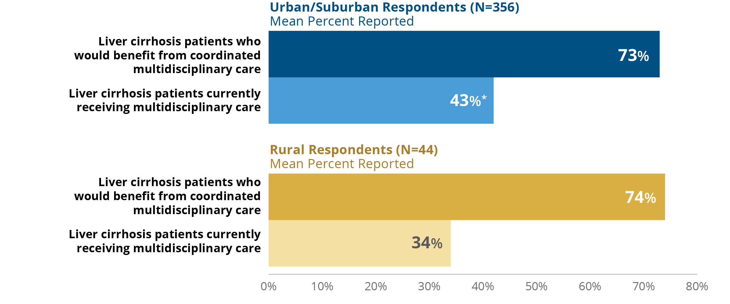
Figure 10 | Disparities in Care | Primary Market Research via Survey
Percent of Cirrhosis Patients Eligible for and/or Receiving Multidisciplinary Care
Q70.1. What percent of your patients with cirrhosis would benefit from and are currently receiving multidisciplinary care?
Respondents report that approximately three-fourths of their patients with cirrhosis would benefit from receiving multidisciplinary care. Respondents working in rural areas report that 34% of their patients with cirrhosis are receiving multidisciplinary care versus those in urban settings, who report 43% of patients getting this type of care. Access
to multidisciplinary care is worse in rural versus urban settings, especially for respondents’ patients with cirrhosis.
N=400 (100 Gastroenterologists, 100 Hospital-based Specialists, 100 PCPs, 100 NPs/PAs [356 practicing in an urban/ suburban setting versus 44 in a rural setting]).
*This number is statistically significant at 95% confidence versus the rural respondents.
Notes:
Figure 10 | Percent of Cirrhosis Patients Eligible for and/or Receiving Multidisciplinary Care
Primary Market Research via Survey
Respondents report that approximately three-fourths of their patients with cirrhosis would benefit from receiving multidisciplinary care. Respondents working in rural areas report that 34% of their patients with cirrhosis are receiving multidisciplinary care versus those in urban settings, who report 43% of patients getting this type of care. Access to multidisciplinary care is worse in rural versus urban settings, especially for respondents’ patients with cirrhosis.

Slide 16
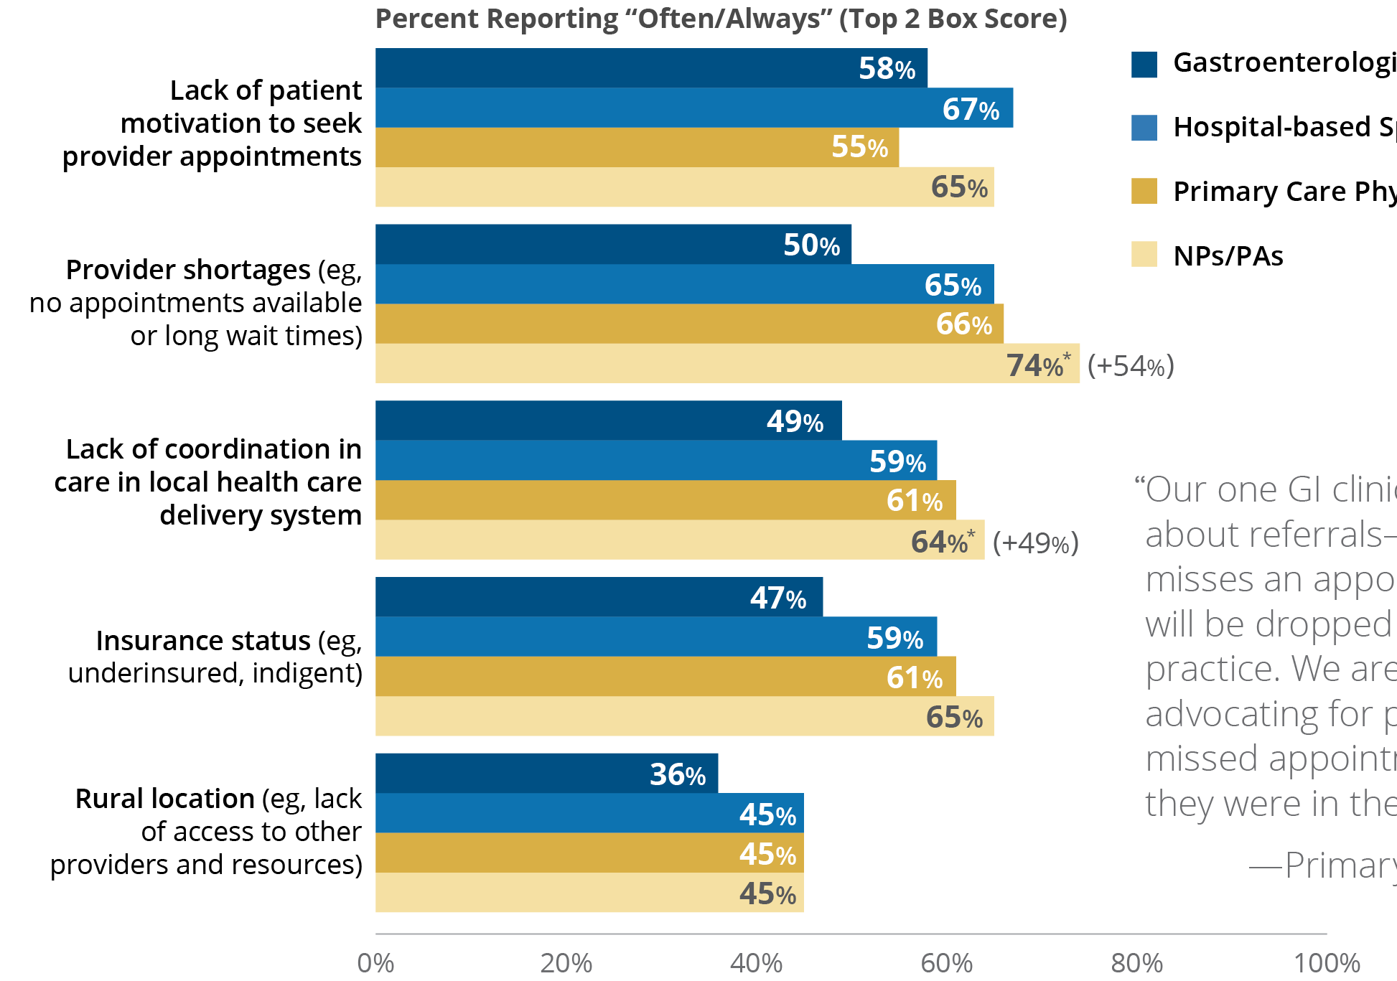
Figure 11 | Disparities in Care | Primary Market Research via Survey
Factors That Most Frequently Impede Patients From Receiving Multidisciplinary Care
Q71. How frequently do the following factors prevent your patients from receiving coordinated multidisciplinary care (eg, primary care, specialists, dietitian, psychosocial support)?
74% of NPs/PAs report that “Provider shortages” are the top reason that CLD patients cannot access multidisciplinary care (a statistically significant increase of 54% versus last year).
Respondents reported that the top 3 reasons that impede patients receiving multidisciplinary care are provider shortages, lack of patient motivation to seek appointments, and insurance status.
N=400 (100 Gastroenterologists, 100 Hospital-based Specialists, 100 PCPs, 100 NPs/PAs).
*This number is statistically significant at 95% confidence versus last year.
Values in parentheses indicate percent change from 2022.
Notes:
Figure 11 | Factors That Most Frequently Impede Patients From Receiving Multidisciplinary Care
Primary Market Research via Survey
Seventy-four percent of NPs/PAs report that “Provider shortages (eg, no appointments available or long wait times)” are the top reason that CLD patients cannot access multidisciplinary care (an increase of 54% versus last year).
Respondents reported that the top 3 reasons that impede patients receiving multidisciplinary care are provider shortages, lack of patient motivation to seek appointments, and insurance status.

Slide 17
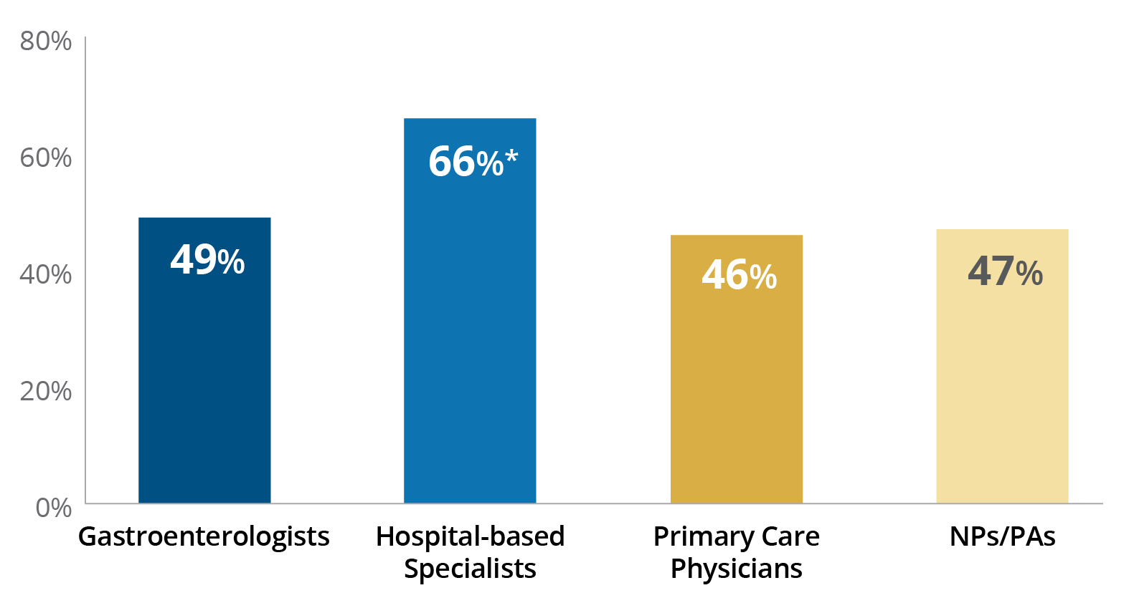
Figure 12 | Disparities in Care | Primary Market Research via Survey
Percent of Multidisciplinary Care Partners Sharing the Same EHR System
Q3.18. What percent of the multidisciplinary care team that you utilize share the same EHR system as you?
For respondents not working
in a hospital environment, less than 50% of multidisciplinary care partners share the same electronic health record (EHR) system.
In telephone interviews, communication and patient continuity of care is thought to be enhanced in settings where providers and care partners share the same EHR system.
N=400 (100 Gastroenterologists, 100 Hospital-based Specialists, 100 PCPs, 100 NPs/PAs).
*This number is statistically significant at 95% confidence versus all others.
Notes:
Figure 12 | Percent of Multidisciplinary Care Partners Sharing the Same EHR System
Primary Market Research via Survey
For respondents not working in a hospital environment, less than 50% of multidisciplinary care partners share the same electronic health record (EHR) system.
In telephone interviews, communication and patient continuity of care are thought to be enhanced in settings where providers and care partners share the same EHR system.

Slide 18
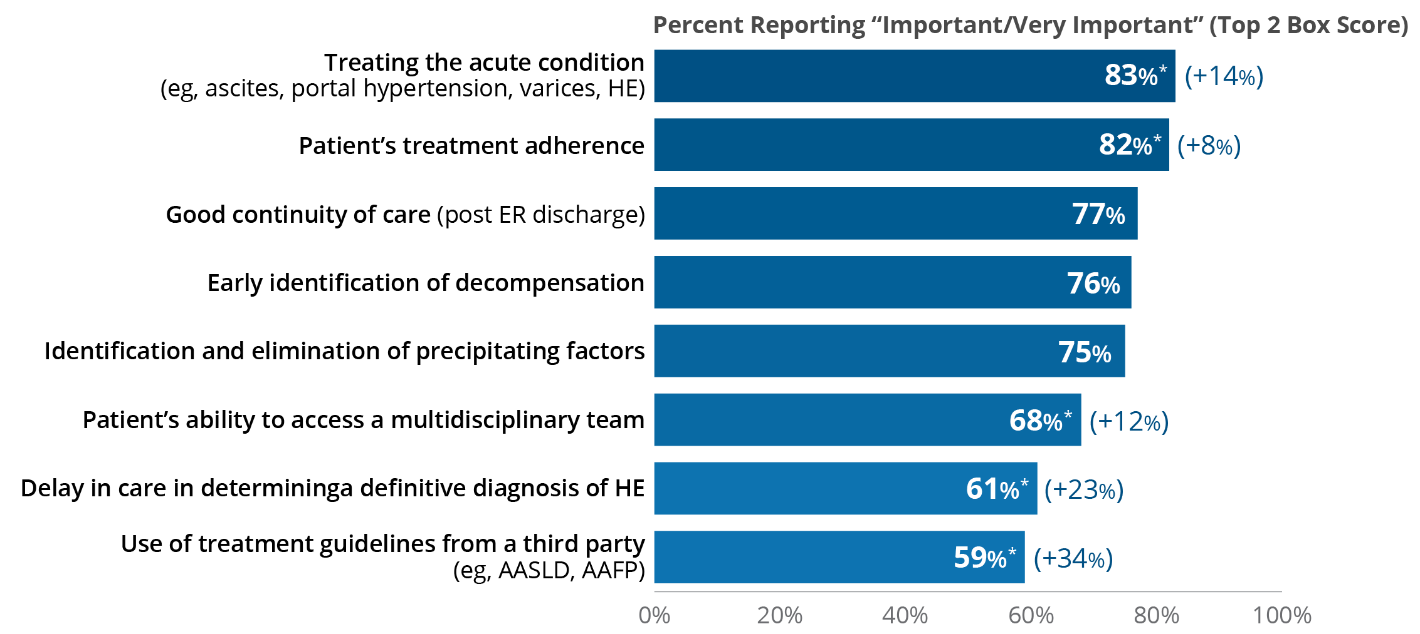
Figure 13 | Care Management | Primary Market Research via Survey
Importance of Care Management on Liver Disease Patient Outcomes
Q3. Please rate the importance of each of these factors with respect to their impact on chronic liver disease patient outcomes. Please use a 7-point scale, where 1=not at all important and 7=very important.
The top 2 care management factors impacting CLD patient outcomes are “Treating the acute condition” and “Patient’s treatment adherence”—both had statically significant increases in their importance ratings versus last year. In telephone interviews, respondents expressed how challenging it is to get patients to engage in treatment for early-stage liver disease (NASH/NAFLD).
Of note, there was a statistically significant increase of 34% in the importance of the use of third-party guidelines versus
2022 (44% to 59%).
N=400 (100 Gastroenterologists, 100 Hospital-based Specialists, 100 PCPs, 100 NPs/PAs).
*This number is statistically significant at 95% confidence versus last year.
Values in parentheses indicate percent change from 2022.
Notes:
Figure 13 | Importance of Care Management on Liver Disease Patient Outcomes
Primary Market Research via Survey
The top 2 care management factors impacting CLD patient outcomes are “Treating the acute condition” and “Patient’s treatment adherence.”
Of note, there was a statistically significant increase of 34% in the importance of the use of third-party guidelines versus 2022 (44% to 59%).

Slide 19
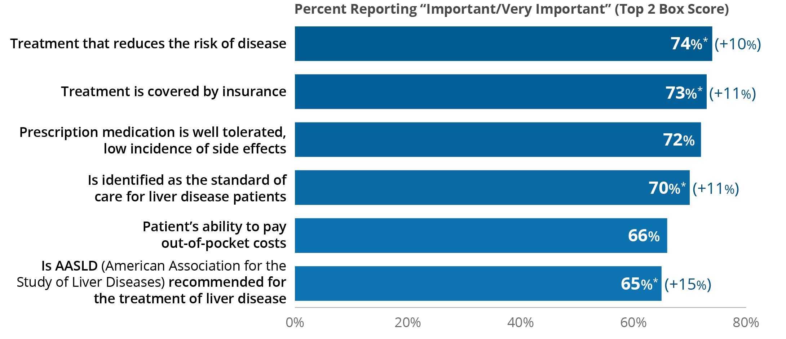
Figure 14 | Care Management | Primary Market Research via Survey
Most Important Factors Considered When Making Treatment Decisions
Q9. Please rate the importance of each of these factors when making treatment decisions for patients with chronic liver disease. Please use a 7-point scale, where 1=not at all important and 7=very important.
When choosing an intervention or treatment for CLD, respondents reported that “Treatment that reduces the risk of disease” and “Treatment is covered by insurance” were again the top 2 most important factors influencing treatment decisions (each receiving statistically significant increases over last year). Factors that reported higher importance ratings this year were ability to access multidisciplinary team members, delay in care getting a hepatic encephalopathy (HE) diagnosis, and use of treatment guidelines from a third party.
N=400 (100 Gastroenterologists, 100 Hospital-based Specialists, 100 PCPs, 100 NPs/PAs).
*This number is statistically significant at 95% confidence versus last year.
Values in parentheses indicate percent change from 2022.
Notes:
Figure 14 | Most Important Factors Considered When Making Treatment Decisions
Primary Market Research via Survey
When choosing an intervention or treatment for CLD, respondents reported that “Treatment that reduces the risk of disease” and “Treatment is covered by insurance” were again the top 2 most important factors influencing treatment decisions (each receiving statistically significant increases over last year). Factors that reported higher importance ratings this year were ability to access multidisciplinary team members, delay in care getting a hepatic encephalopathy (HE) diagnosis, and use of treatment guidelines from a third party.

Slide 20
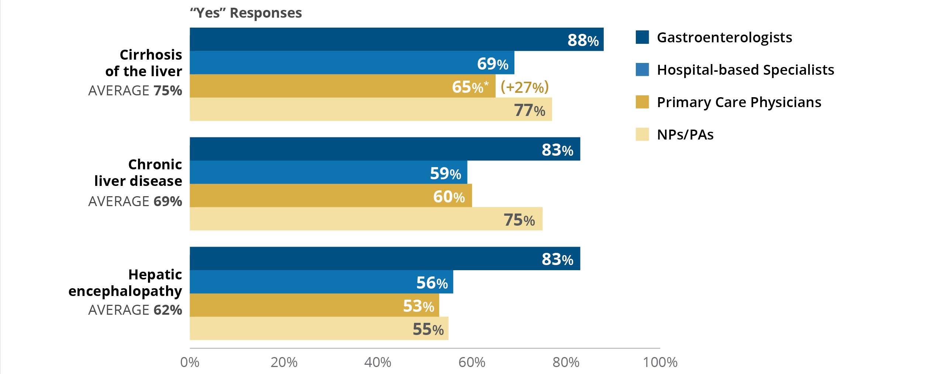
Figure 15 | Care Management | Primary Market Research via Survey
Respondent Awareness of National Guidelines for Liver Disease Management
Q5. Are you aware of any national guidelines for the management of patients suffering from chronic liver disease?
Thirty-one percent of surveyed respondents, who treat liver disease,
are unaware of any national guidelines for the management of CLD.
Gastroenterologists continue to have the highest awareness of national guidelines for liver disease management.
There were no significant changes in awareness of guidelines except PCPs, who reported a statistically significant increase in awareness for cirrhosis guidelines of 27% versus last year (51% to 65%).
N size varies by answer.
*This number is statistically significant at 95% confidence versus last year.
Values in parentheses indicate percent change from 2022.
Notes:
Figure 15 | Respondent Awareness of National Guidelines for Liver Disease Management
Primary Market Research via Survey
Thirty-one percent of surveyed respondents, who treat liver disease, are unaware of any national guidelines for the management of CLD.
Gastroenterologists continue to have the highest awareness of national guidelines for liver disease management.
There were no significant changes in awareness of guidelines except PCPs, who reported a statistically significant increase in awareness for cirrhosis guidelines, an increase of 27% versus last year (51% to 65%).

Slide 21
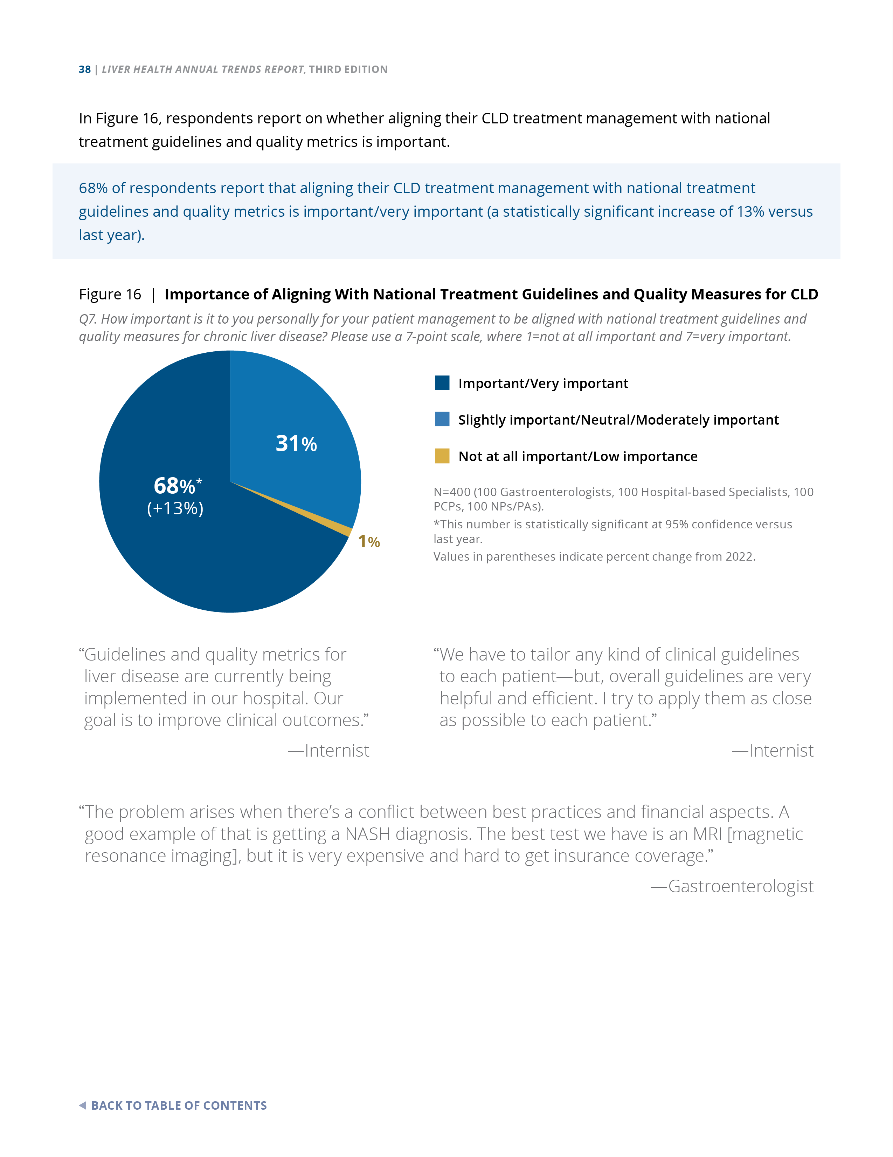
Figure 16 | Care Management | Primary Market Research via Survey
Importance of Aligning With National Treatment Guidelines and Quality Measures for CLD
Q7. How important is it to you personally for your patient management to be aligned with national treatment guidelines and quality measures for chronic liver disease? Please use a 7-point scale, where 1=not at all important and 7=very important.
68% of respondents report that aligning their CLD treatment management with national treatment guidelines and quality metrics is important/very important (a statistically significant increase of 13% versus last year).
N=400 (100 Gastroenterologists, 100 Hospital-based Specialists, 100 PCPs, 100 NPs/PAs).
*This number is statistically significant at 95% confidence versus last year.
Values in parentheses indicate percent change from 2022.
Notes:
Figure 16 | Importance of Aligning With National Treatment Guidelines and Quality Measures for CLD
Primary Market Research via Survey
Sixty-eight percent of respondents reported that it is important/very important to align their CLD treatment management with national treatment guidelines, a statistically significant increase of 13% versus last year.

Slide 22
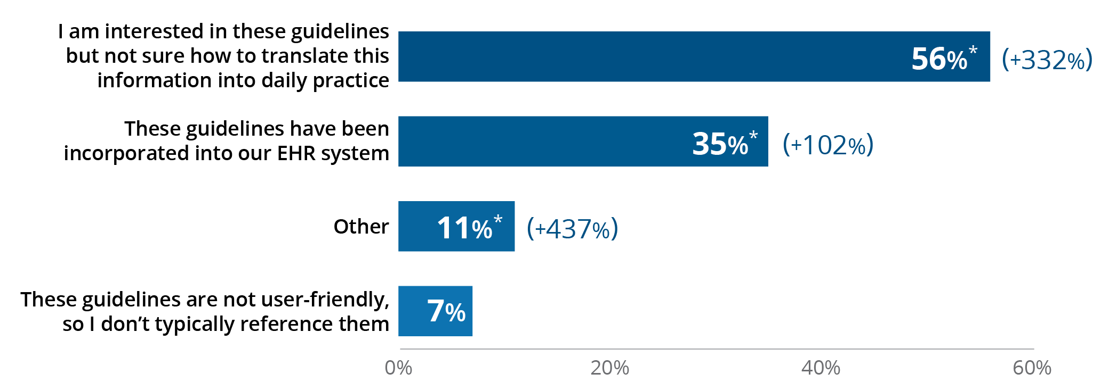
Figure 17 | Care Management | Primary Market Research via Survey
How National Guidelines Are Incorporated Into Care Management
Q63. Please select the statements that best represent how you utilize these guidelines and/or pathways to manage your liver disease patients.
Of those who said they utilize national guidelines for liver disease care management (N=320), 56% of respondents say they are interested in these guidelines but not sure how to translate the information into daily practice, a statistically significant increase of 332% versus last year.
35% of respondents report that national guidelines have been incorporated into their electronic health record (EHR) system, a statistically significant increase of 102% over last year.
In telephone interviews, respondents felt that improvements needed to be made to national guidelines, which included:
The use of noninvasive tests for a definitive NASH or NAFLD diagnosis
Making the guidelines less “academic” and more user-friendly in the clinical setting
N=320 (92 Gastroenterologists, 77 Hospital-based Specialists, 71 PCPs, 80 NPs/PAs).
*This number is statistically significant at 95% confidence versus last year.
Values in parentheses indicate percent change from 2022.
Notes:
Figure 17 | How National Guidelines Are Incorporated Into Care Management
Primary Market Research via Survey
Of those who said they utilize national guidelines for liver disease care management (N=320), 56% of respondents say they are interested in these guidelines but not sure how to translate the information into daily practice, a statistically significant increase of 332% versus last year.
35% of respondents report that national guidelines have been incorporated into their electronic health record (EHR) system, a statistically significant increase of 102% over last year.
In telephone interviews, respondents felt that improvements needed to be made to national guidelines, which included:
The use of noninvasive tests for a definitive NASH or NAFLD diagnosis
Making the guidelines less “academic” and more user-friendly in the clinical setting

Slide 23
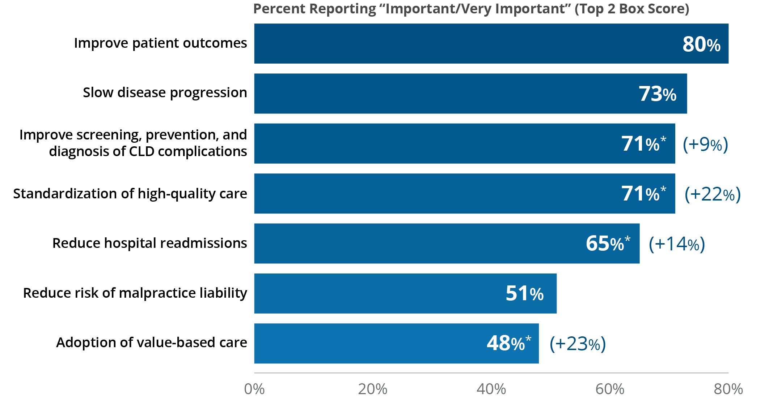
Figure 18 | Care Management | Primary Market Research via Survey
Factors Important in Driving Provider Utilization of Guidelines
Q12. Please rate the following factors in order of their importance in driving provider use and adoption of chronic liver disease guidelines. Please use a 7-point scale, where 1=not at all important and 7=very important.
80% of respondents report improving CLD patient outcomes as being the most important reason to adopt guidelines.
N=400 (100 Gastroenterologists, 100 Hospital-based Specialists, 100 PCPs, 100 NPs/PAs).
*This number is statistically significant at 95% confidence versus last year.
Values in parentheses indicate percent change from 2022.
Notes:
Figure 18 | Factors Important in Driving Provider Utilization of Guidelines
Primary Market Research via Survey
Eighty percent of respondents report improving CLD patient outcomes as being the most important reason for providers to adopt guidelines. Other important factors included slowing disease progression and improving screening, prevention, and diagnosis of CLD complications.

Slide 24
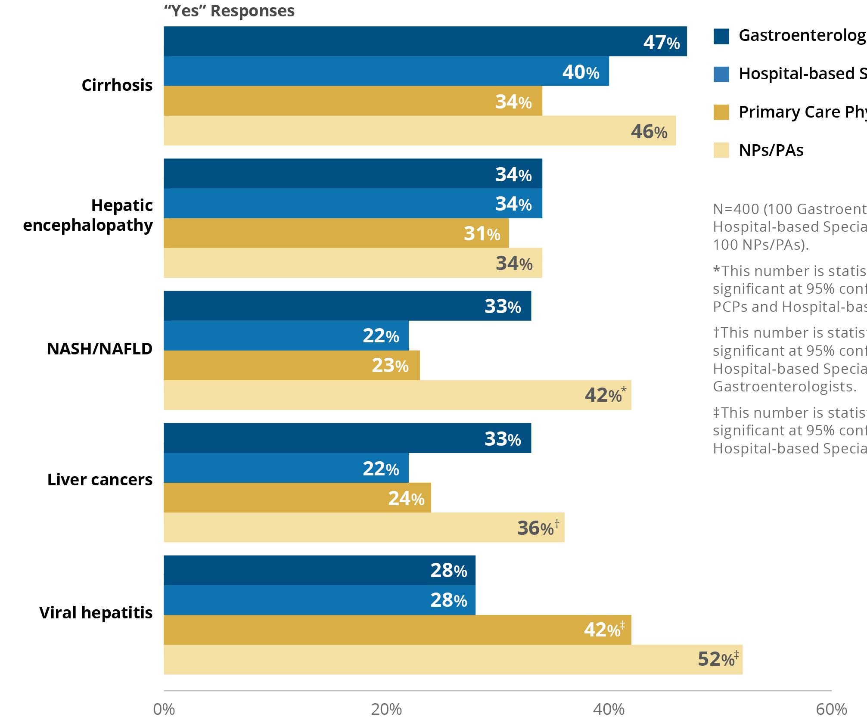
Figure 19 | Care Management | Primary Market Research via Survey
Organizations Who Have Written Guidance and/or Quality Measures for Liver Diseases
Q4. Does your organization have written guidance or quality measures for the following diseases of the liver?
Overall, 42% of all respondents report having written guidance and/or quality metrics in their organizations.
Guidelines for cirrhosis appear most frequently in gastroenterologist and hospital-based specialist organizations, while PCPs and NPs/PAs most frequently have guidelines for viral hepatitis.
Overall, written guidance and/or quality metrics are more prevalent for cirrhosis in respondents who are in urban/suburban locations versus rural (44% versus 25%, respectively, at 95% confidence).
N=400 (100 Gastroenterologists, 100 Hospital-based Specialists, 100 PCPs, 100 NPs/PAs).
*This number is statistically significant at 95% confidence versus PCPs and Hospital-based Specialists.
†This number is statistically significant at 95% confidence versus Hospital-based Specialists and Gastroenterologists.
‡This number is statistically significant at 95% confidence versus Hospital-based Specialists.
Notes:
Figure 19 | Organizations Who Have Written Guidance and/or Quality Measures for Liver Diseases
Primary Market Research via Survey
Overall, 42% of all respondents report having written guidance and/or quality metrics in their organizations.
Guidelines for cirrhosis appear most frequently in gastroenterologist and hospital-based specialist organizations, while PCPs and NPs/PAs most frequently have guidelines for viral hepatitis.
Overall, written guidance and/or quality metrics are more prevalent for cirrhosis in respondents who are in urban/suburban locations versus rural (44% versus 25%, respectively, at 95% confidence).
Survey data and telephone interviews pointed to disparities in care for patients in rural versus urban/suburban locations. For example:
Lower respondent awareness of guidelines (eg, cirrhosis)

Slide 25
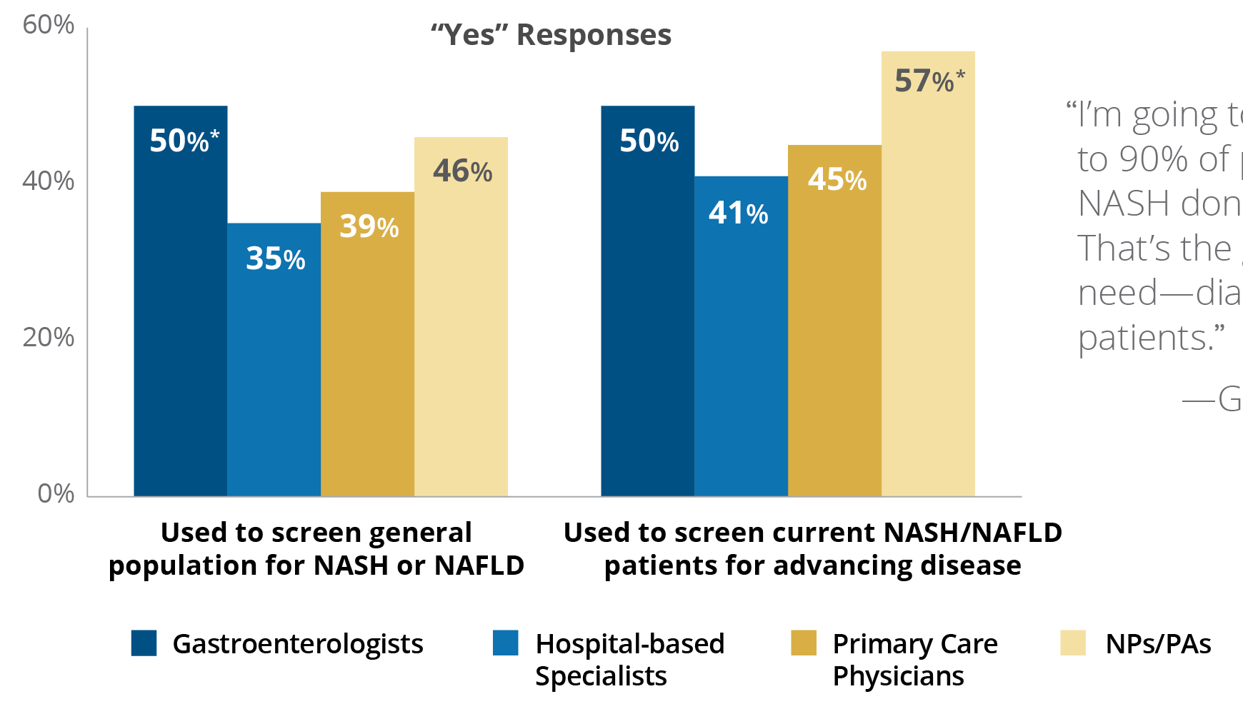
Figure 20 | Care Management | Primary Market Research via Survey
Utilization of the APRI Score to Identify NASH/NAFLD and Disease Progression
Q3.10. In your practice setting, do you utilize an APRI (ALT-to-platelet ratio index) Score to identify the following patients: (A) Used to screen general patient population for NASH or NAFLD (B) Used to screen current NASH/NAFLD patients for advancing disease?
43% of respondents utilize the APRI Score test to identify NASH or NAFLD patients, and 48% used the test to identify disease progression (eg, fibrosis, cirrhosis) in this patient population.
N=400 (100 Gastroenterologists, 100 Hospital-based Specialists, 100 PCPs, 100 NPs/PAs).
*This number is statistically significant at 95% confidence versus Hospital-based Specialists.
Notes:
Figure 20 | Utilization of the APRI Score to Identify NASH/NAFLD and Disease Progression
Primary Market Research via Survey
Forty-three percent of respondents utilize the APRI (ALT-to-platelet ratio index) Score test to identify NASH or NAFLD patients, and 48% used the test to identify disease progression (eg, fibrosis, cirrhosis) in this patient population.

Slide 26
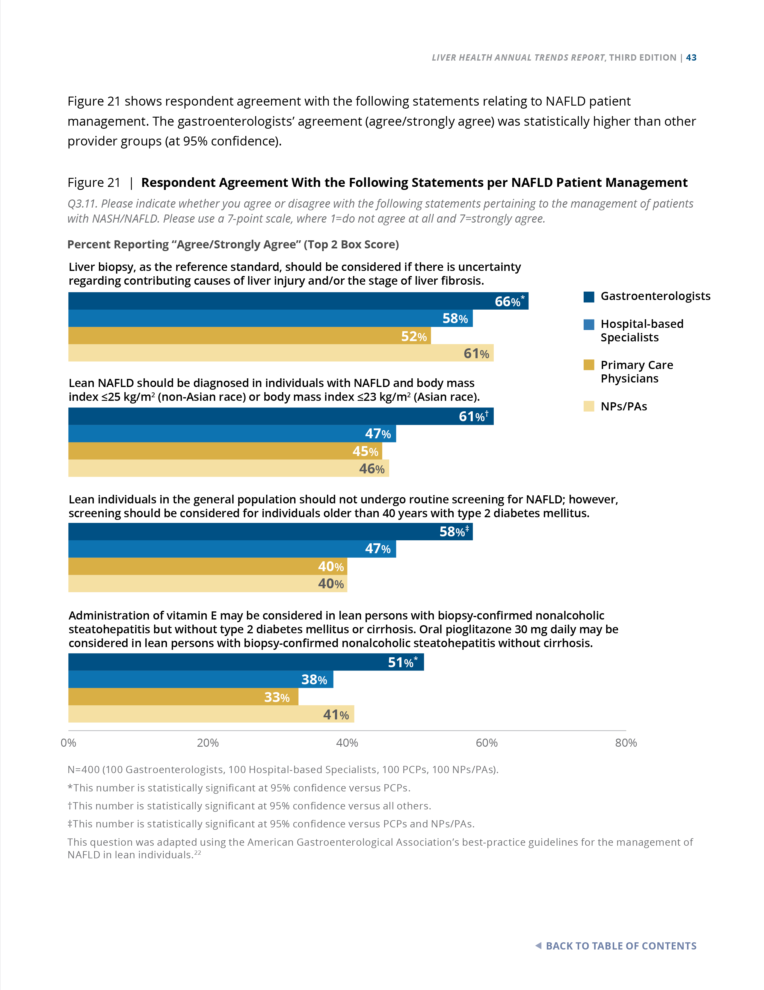
Figure 21 | Care Management | Primary Market Research via Survey
Respondent Agreement With the Following Statements per NAFLD Patient Management
Q3.11. Please indicate whether you agree or disagree with the following statements pertaining to the management of patients with NASH/NAFLD. Please use a 7-point scale, where 1=do not agree at all and 7=strongly agree.
N=400 (100 Gastroenterologists, 100 Hospital-based Specialists, 100 PCPs, 100 NPs/PAs).
*This number is statistically significant at 95% confidence versus PCPs.
†This number is statistically significant at 95% confidence versus all others.
‡This number is statistically significant at 95% confidence versus PCPs and NPs/PAs.
This question was adapted using the American Gastroenterological Association’s best-practice guidelines for the management of NAFLD in lean individuals.
Notes:
Figure 21 | Respondent Agreement With the Following Statements per NAFLD Patient Management
Primary Market Research via Survey
Figure 21 shows respondent agreement with the following statements relating to NAFLD patient management. The gastroenterologists’ agreement (agree/strongly agree) was statistically higher than other provider groups (at 95% confidence).
The question was adapted using the American Gastroenterological Association’s best-practice guidelines for the management of NAFLD in lean individuals.¹
Reference: 1. Long MT, Noureddin M, Lim JK. AGA clinical practice update: diagnosis and management of nonalcoholic fatty liver disease in lean individuals: expert review. Gastroenterology. 2022;163:754-774.

Slide 27
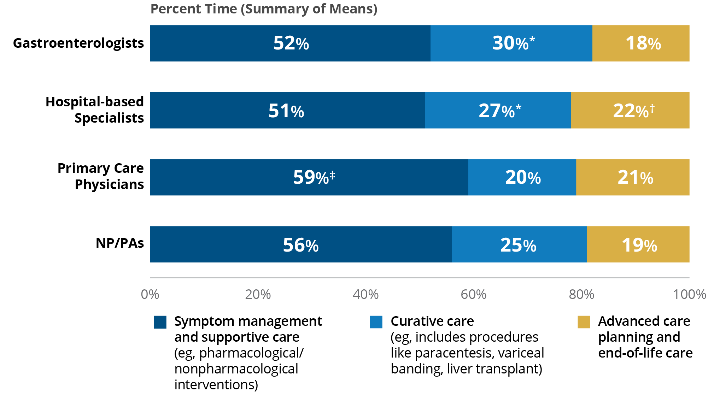
Figure 22 | Care Management | Primary Market Research via Survey
Provider Management Focus for Cirrhotic Patients
Q3.9. Of the cirrhotic patients that are currently in your practice, how much time do you spend on the following
3 areas of care management?
N=400 (100 Gastroenterologists,
100 Hospital-based Specialists,
100 PCPs, 100 NPs/PAs).
*This number is statistically significant at 95% confidence versus PCPs.
†This number is statistically significant at 95% confidence versus Gastroenterologists.
‡This number is statistically significant at 95% confidence versus Hospital-based Specialists and Gastroenterologists.
With respect to patients with cirrhosis, approximately 50% of specialist time (gastroenterologist and hospital-based specialists) is spent on symptom management and supportive care, approximately 30% on curative interventions, and the remaining time on palliative care and end-of-life planning.
Notes:
Figure 22 | Provider Management Focus for Cirrhotic Patients
Primary Market Research via Survey
With respect to patients with cirrhosis, approximately 50% of specialist time (gastroenterologist and hospital-based specialists) is spent on symptom management and supportive care, approximately 30% on curative interventions, and the remaining time on palliative care and end-of-life planning.

Slide 28
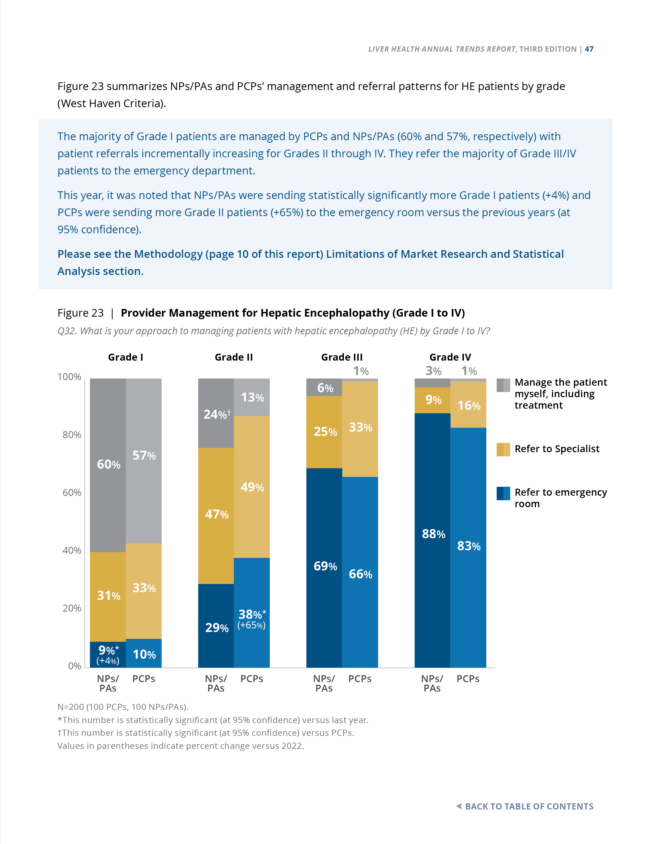
Figure 23 | Care Management | Primary Market Research via Survey
Provider Management for Hepatic Encephalopathy (Grade I to IV)
Q32. What is your approach to managing patients with hepatic encephalopathy (HE) by Grade I to IV?
The majority of Grade I patients are managed by PCPs and NPs/PAs
(60% and 57%, respectively) with patient referrals incrementally increasing for Grades II through IV. They refer the majority of Grade III/IV patients to the emergency department.
N=200 (100 PCPs, 100 NPs/PAs).
*This number is statistically significant (at 95% confidence) versus last year.
†This number is statistically significant (at 95% confidence) versus PCPs.
Values in parentheses indicate percent change versus 2022.
This year, it was noted that NPs/PAs were sending statistically significantly more Grade I patients (+4%) and PCPs were sending more Grade II patients (+65%) to the emergency room versus the previous years (at 95% confidence).
Notes:
Figure 23 | Provider Management for Hepatic Encephalopathy (Grade I to IV)
Primary Market Research via Survey
This year, PCPs were sending more Grade II patients (+65%) to the emergency room versus the previous years (at 95% confidence).
The majority of Grade I patients are managed by PCPs and NPs/PAs (60% and 57%, respectively) with patient referrals incrementally increasing for Grades II through IV. They refer the majority of Grade III/IV patients to the emergency department.

Slide 29
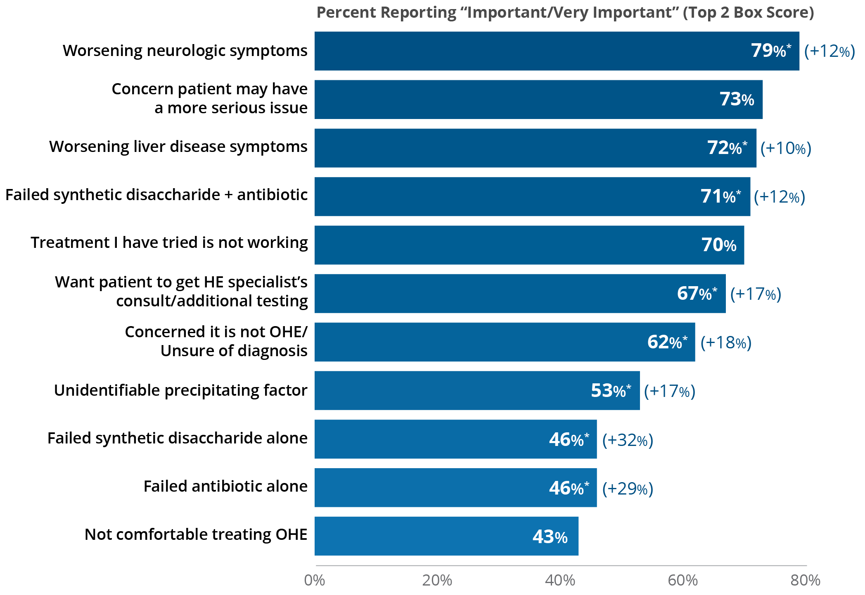
Figure 24 | Care Management | Primary Market Research via Survey
Factors Important in Determining Decision to Get a Referral or Consult for OHE
Q37. Please rate the importance of the following factors in determining your decision to get a referral or consult for a patient who has overt hepatic encephalopathy (OHE). Please use a 7-point scale, where 1=not at all important and 7=very important.
79% of respondents rated worsening neurologic symptoms as the most important factor that prompts the decision to seek a referral or consult for OHE. This factor increased 12% versus 2022 (at 95% confidence) and was a result of higher importance ratings this year by the hospital-based specialists and NPs/PAs.
N=400 (100 Gastroenterologists, 100 Hospital-based Specialists, 100 PCPs, 100 NPs/PAs).
*This number is statistically significant at 95% confidence versus last year.
Values in parentheses indicate percent change from 2022.
Notes:
Figure 24 | Factors Important in Determining Decision to Get a Referral or Consult for OHE
Primary Market Research via Survey
Figure 24 shows the importance ratings for factors that determine a decision for a referral and/or consult for a patient who has overt hepatic encephalopathy (OHE).
79% of respondents rated worsening neurologic symptoms as the most important factor that prompts the decision to seek a referral or consult for OHE. This factor increased 12% versus 2022 (at 95% confidence) and was a result of higher importance ratings this year by the hospital-based specialists and NPs/PAs.

Slide 30
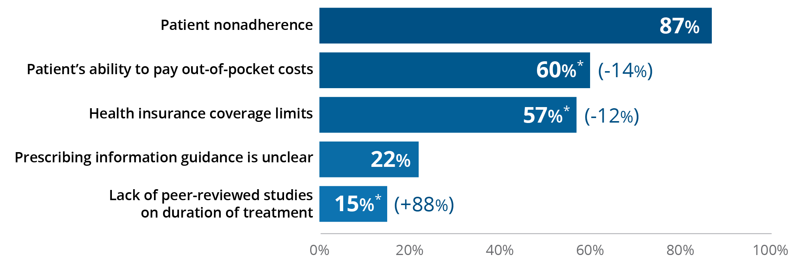
Figure 25 | Care Management | Primary Market Research via Survey
Factors That Most Commonly Limit Duration of Treatment for the Prevention of OHE Recurrence
Q58. What factors most commonly limit the duration of treatment for the prevention of hepatic encephalopathy (HE) recurrence? Please select all that apply.
While the vast majority of respondents (89%) recognize that the duration of treatment for HE is indefinite, many factors can interfere, causing interruptions in therapy and/or recurrent OHE.
87% of respondents cite patient nonadherence as the most common factor that limits the duration of treatment to prevent HE recurrence.
N=400 (100 Gastroenterologists, 100 Hospital-based Specialists, 100 PCPs, 100 NPs/PAs).
*This number is statistically significant at 95% confidence versus last year.
Values in parentheses indicate percent change from 2022.
Notes:
Figure 25 | Factors That Most Commonly Limit Duration of Treatment for the Prevention of OHE Recurrence
Primary Market Research via Survey
Eighty-seven percent of respondents cite patient noncompliance as the most common factor that limits the duration of treatment to prevent HE recurrence.
While the vast majority of respondents (89%) recognize that the duration of treatment for HE is indefinite, many factors can interfere, causing interruptions in therapy and/or recurrent OHE.
87% of respondents cite patient nonadherence as the most common factor that limits the duration of treatment to prevent HE recurrence.

Slide 31
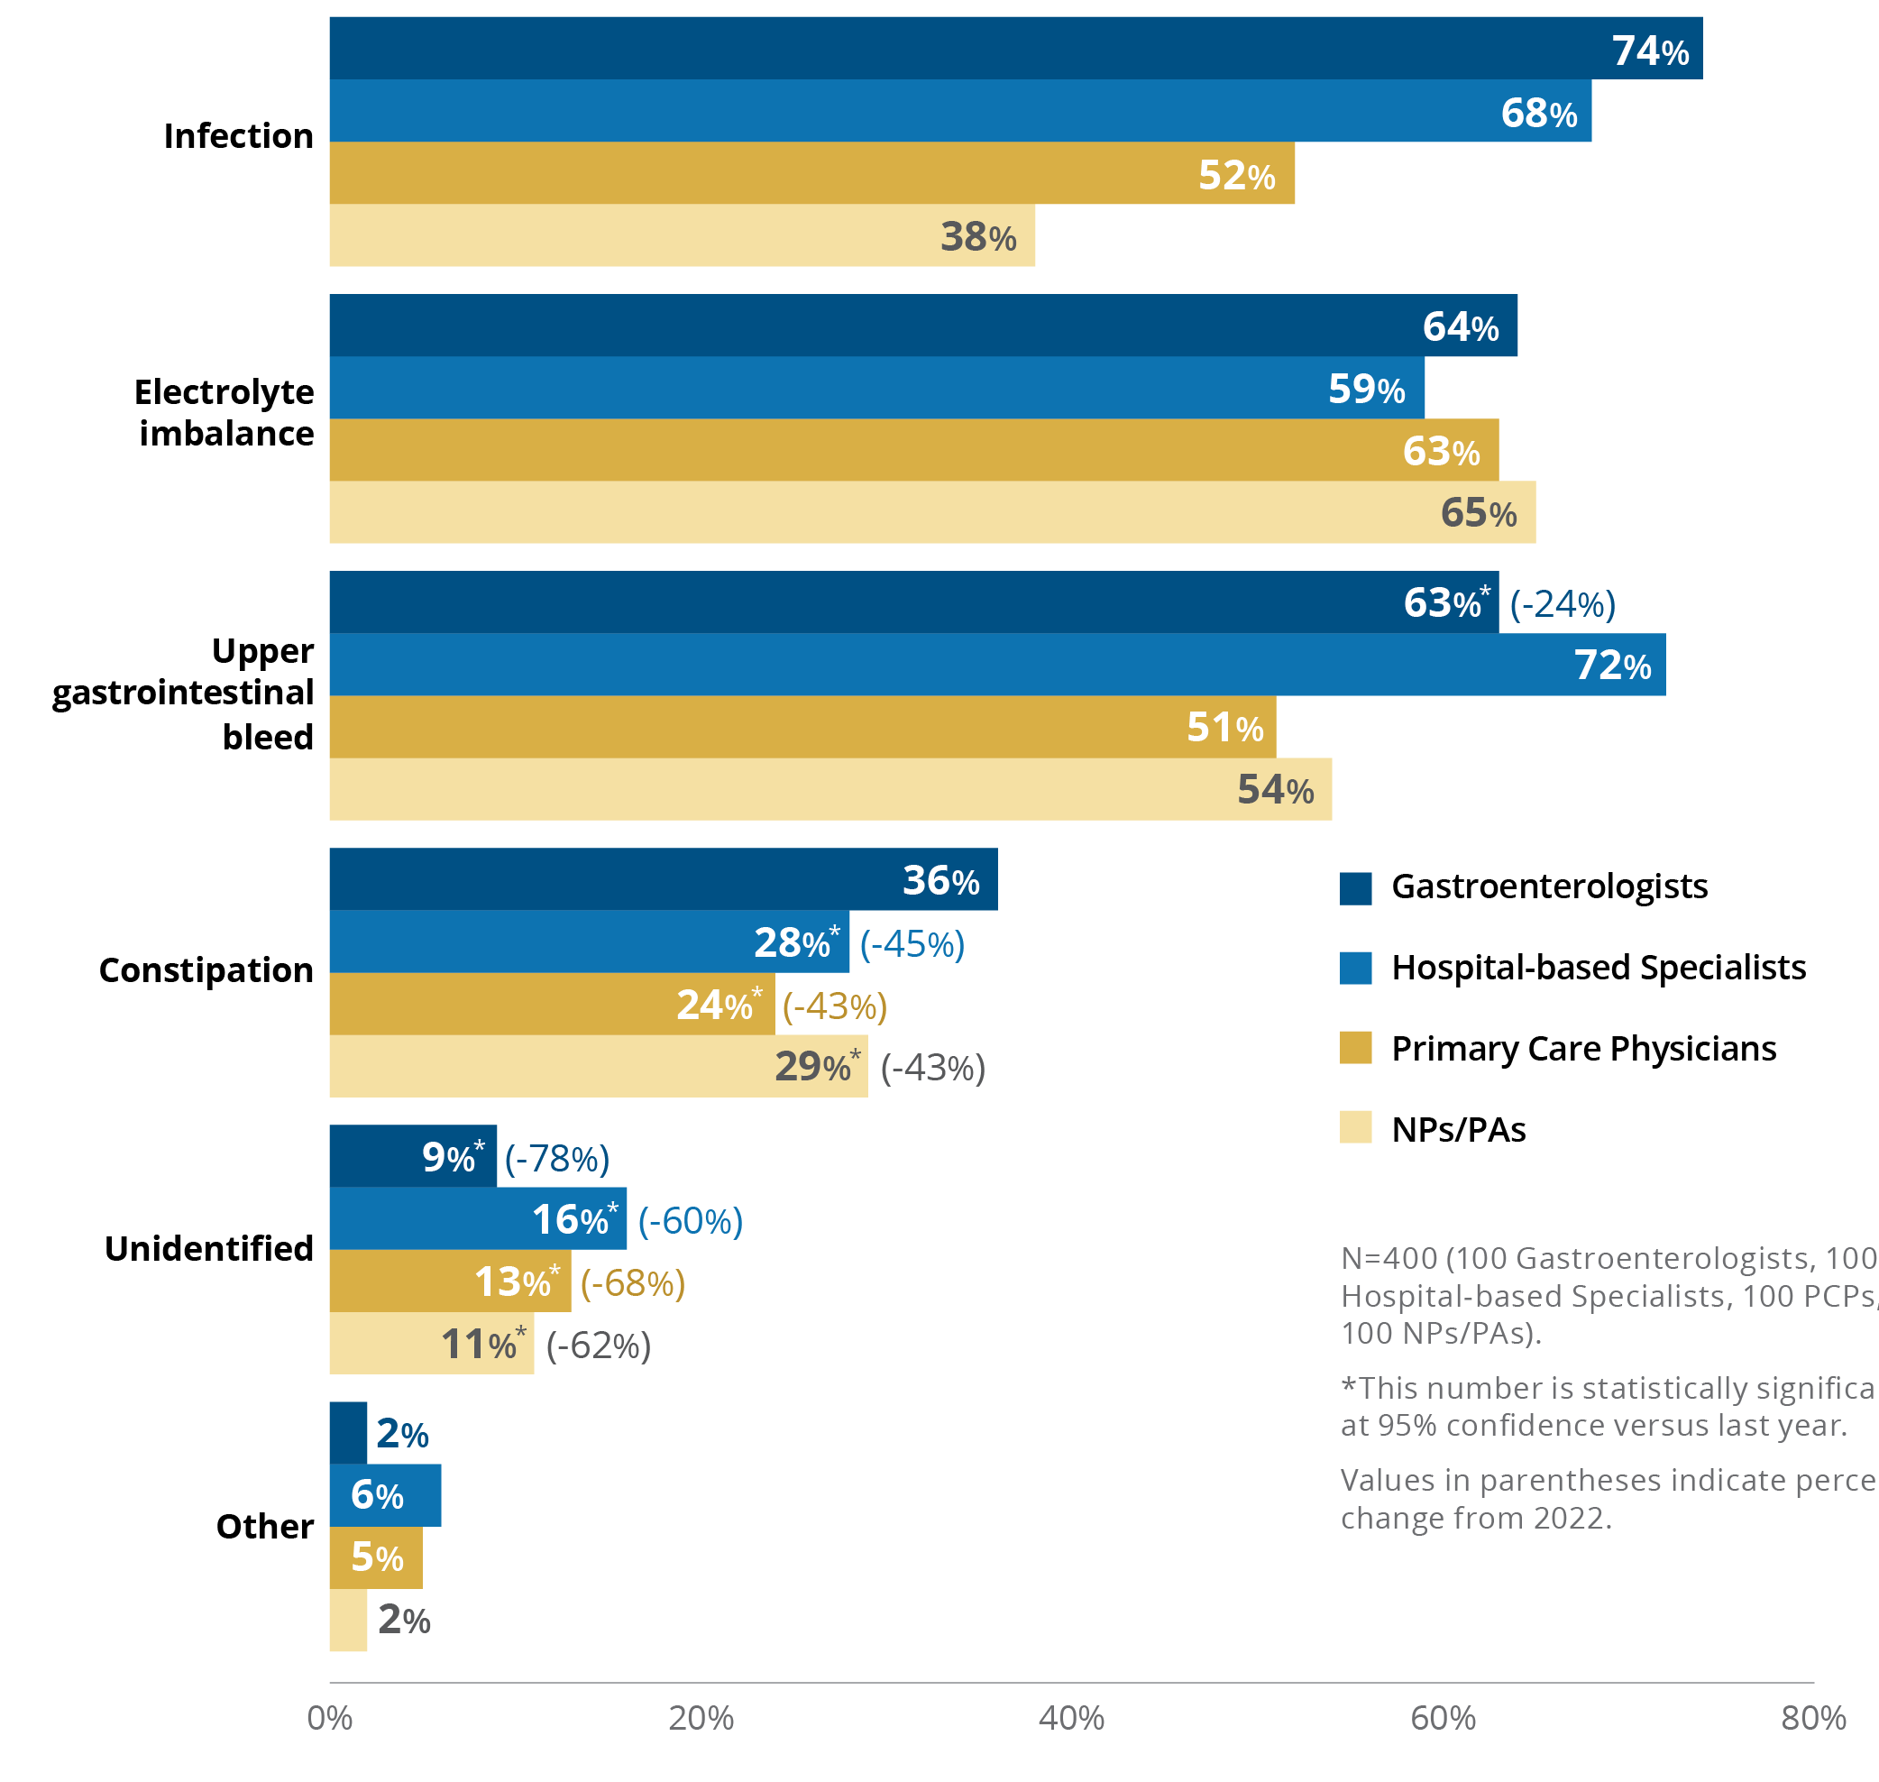
Figure 26 | Care Management | Primary Market Research via Survey
Most Common Precipitating Factors in Newly Diagnosed OHE Patients
Q35b. Which precipitating factors most commonly present in your newly diagnosed overt hepatic encephalopathy (OHE) patients? Please select all that apply.
74% of gastroenterologists report that infections are the most common precipitating factor in their practice setting for those newly diagnosed with HE.
Not surprisingly, 72% of hospital-based specialists see upper bleeds more commonly, whereas 63% of PCPs and 65% of NPs/PAs see electrolyte imbalances.
N=400 (100 Gastroenterologists, 100 Hospital-based Specialists, 100 PCPs, 100 NPs/PAs).
*This number is statistically significant at 95% confidence versus last year.
Values in parentheses indicate percent change from 2022.
Notes:
Figure 26 | Most Common Precipitating Factors in Newly Diagnosed OHE Patients
Primary Market Research via Survey
Respondents report on the most common precipitating factors in newly diagnosed OHE.
74% of gastroenterologists report that infections are the most common precipitating factor in their practice setting for those newly diagnosed with HE.
Not surprisingly, 72% of hospital-based specialists see upper bleeds more commonly, whereas 63% of PCPs and 65% of NPs/PAs see electrolyte imbalances.

Slide 32
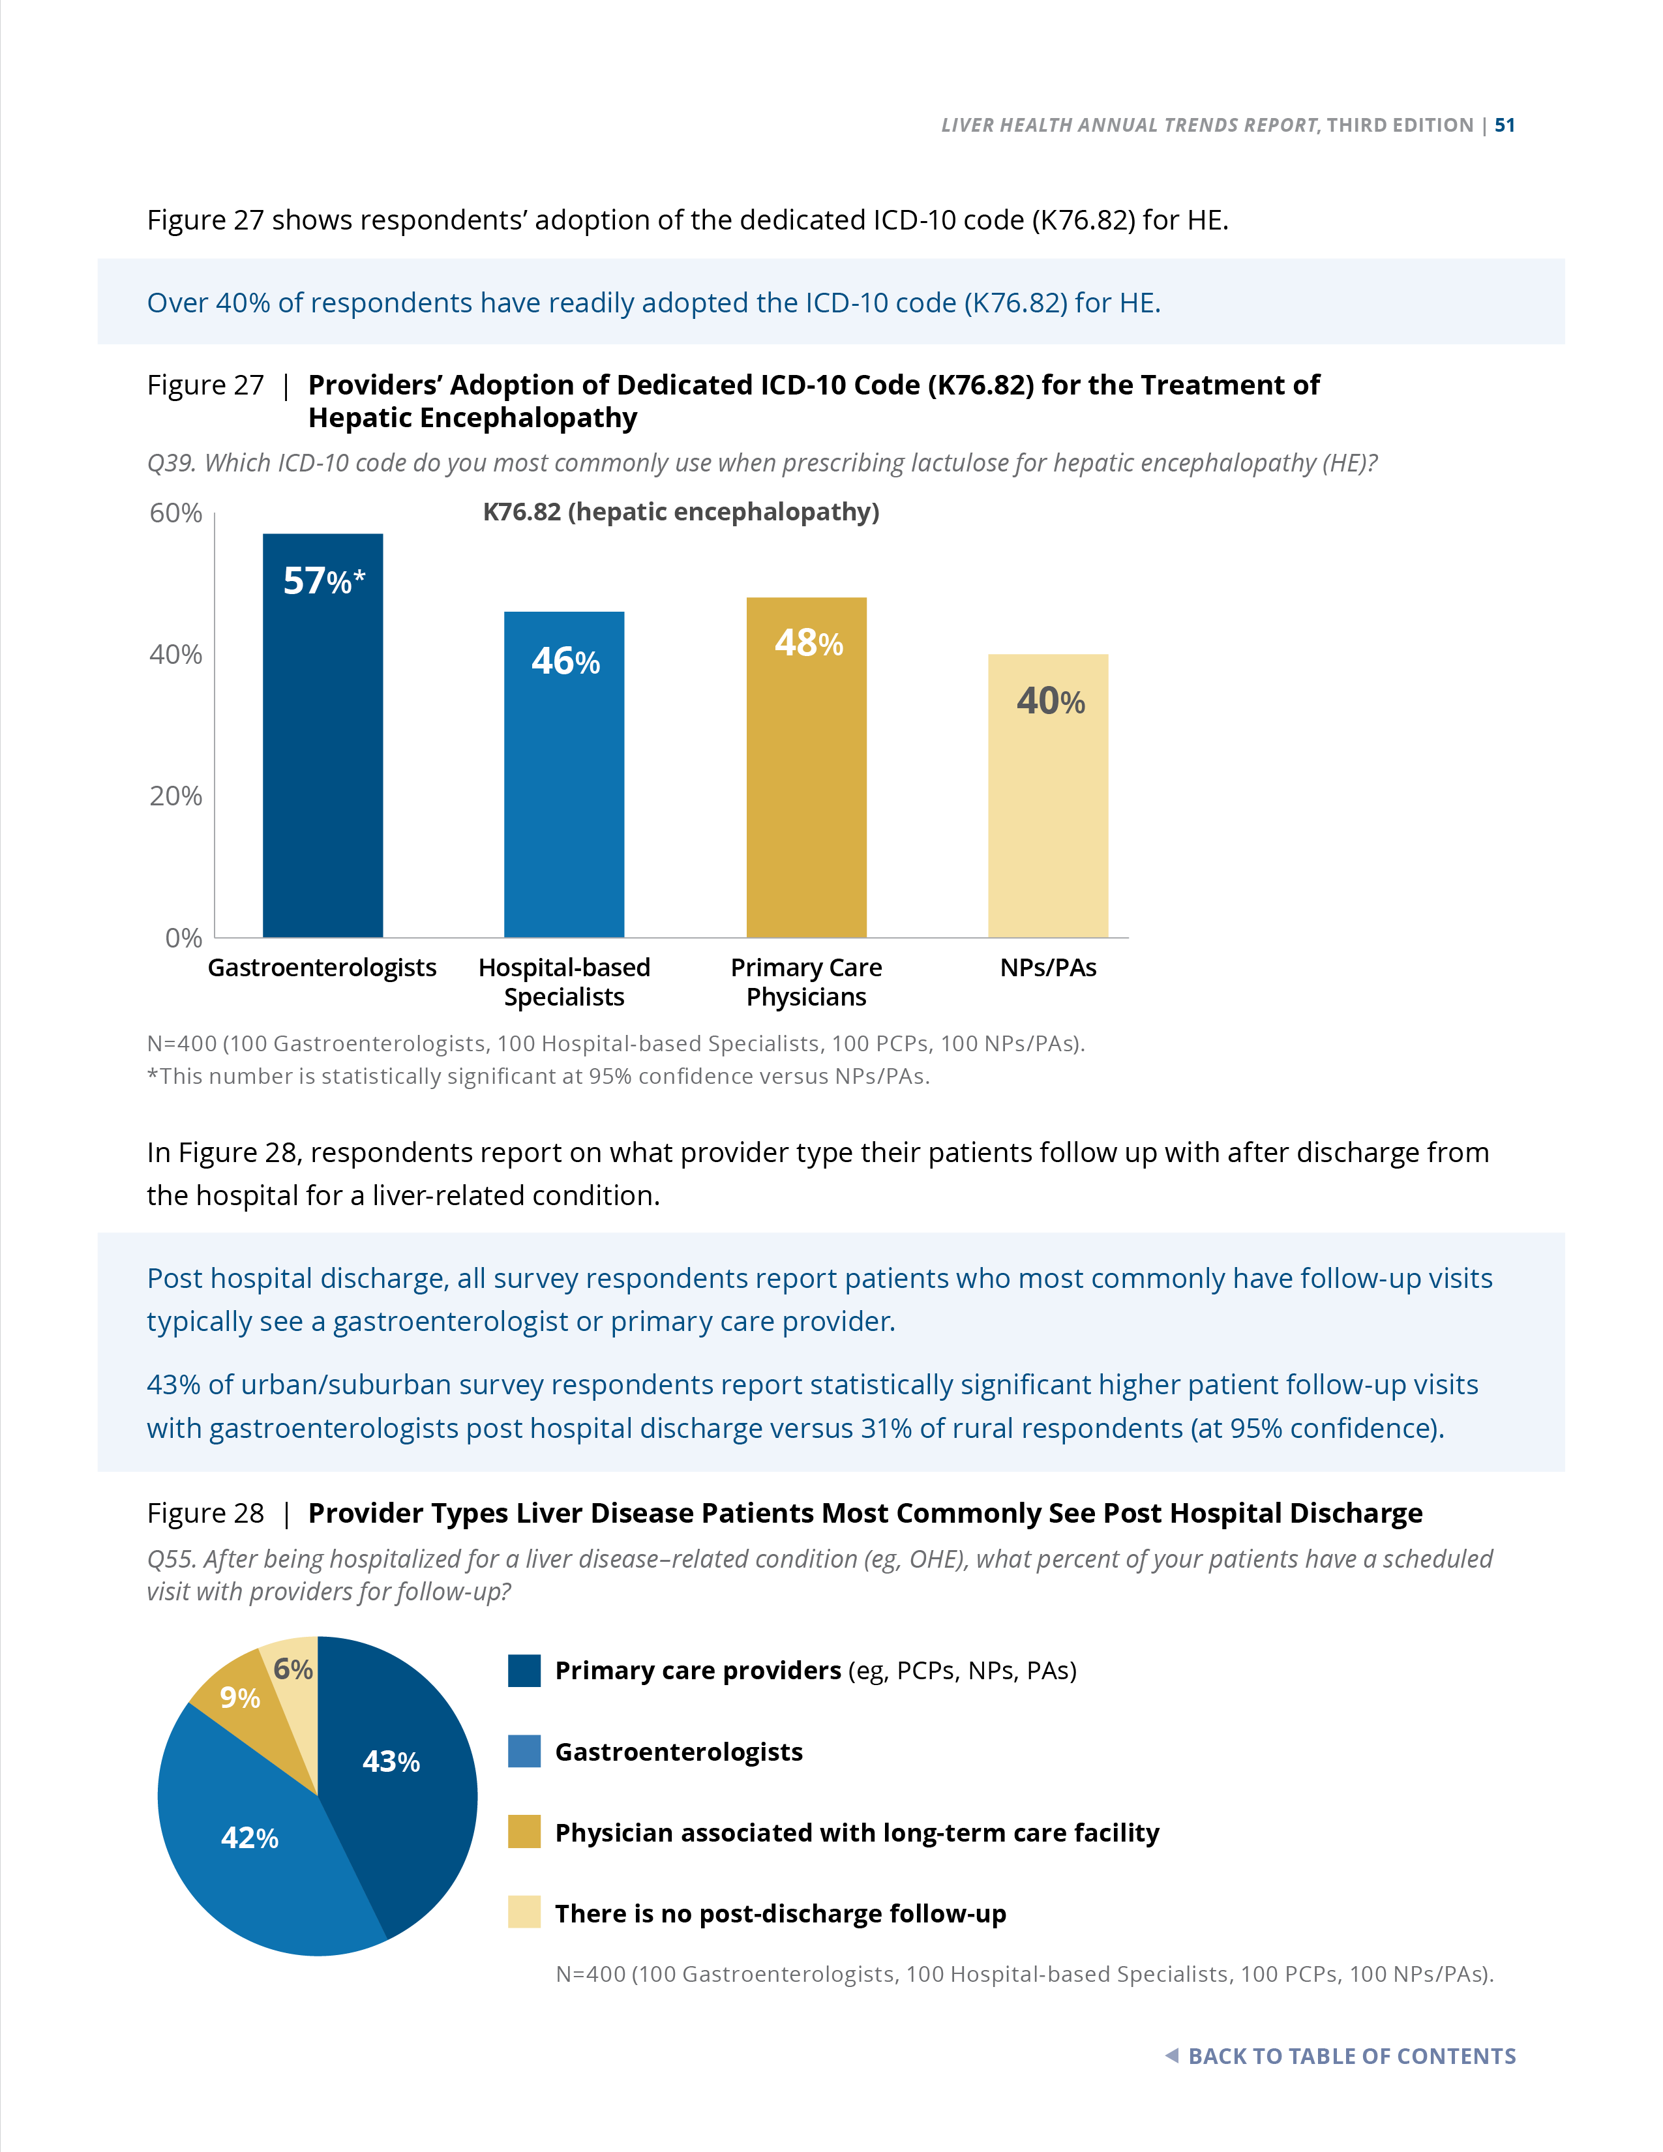
Figure 27 | Care Management | Primary Market Research via Survey
Providers’ Adoption of Dedicated ICD-10 Code (K76.82) for the Treatment of Hepatic Encephalopathy
Q39. Which ICD-10 code do you most commonly use when prescribing lactulose for hepatic encephalopathy (HE)?
Over 40% of respondents have readily adopted the ICD-10 code (K76.82) for HE.
N=400 (100 Gastroenterologists, 100 Hospital-based Specialists, 100 PCPs, 100 NPs/PAs).
*This number is statistically significant at 95% confidence versus NPs/PAs.
Notes:
Figure 27 | Providers’ Adoption of Dedicated ICD-10 Code (K76.82) for the Treatment of Hepatic Encephalopathy
Primary Market Research via Survey
Over 40% of respondents have readily adopted the dedicated ICD-10 code (K76.82) for HE.

Slide 33
Figure 28 | Care Management | Primary Market Research via Survey
Provider Types Liver Disease Patients Most Commonly See Post Hospital Discharge
Q55. After being hospitalized for a liver disease–related condition (eg, OHE), what percent of your patients have a scheduled visit with providers for follow-up?
Post hospital discharge, all survey respondents report patients who most commonly have follow-up visits typically see a gastroenterologist or primary care provider.
43% of urban/suburban survey respondents report statistically significant higher patient follow-up visits with gastroenterologists post hospital discharge versus 31% of rural respondents (at 95% confidence).
N=400 (100 Gastroenterologists, 100 Hospital-based Specialists, 100 PCPs, 100 NPs/PAs).
Notes:
Figure 28 | Provider Types Liver Disease Patients Most Commonly See Post Hospital Discharge
Primary Market Research via Survey
Respondents report on what provider type their patients follow up with after discharge from the hospital for a liver-related condition.
Post hospital discharge, all survey respondents report patients who most commonly have follow-up visits typically see a gastroenterologist or primary care provider.
43% of urban/suburban survey respondents report statistically significant higher patient follow-up visits with gastroenterologists post hospital discharge versus 31% of rural respondents (at 95% confidence).

Slide 34
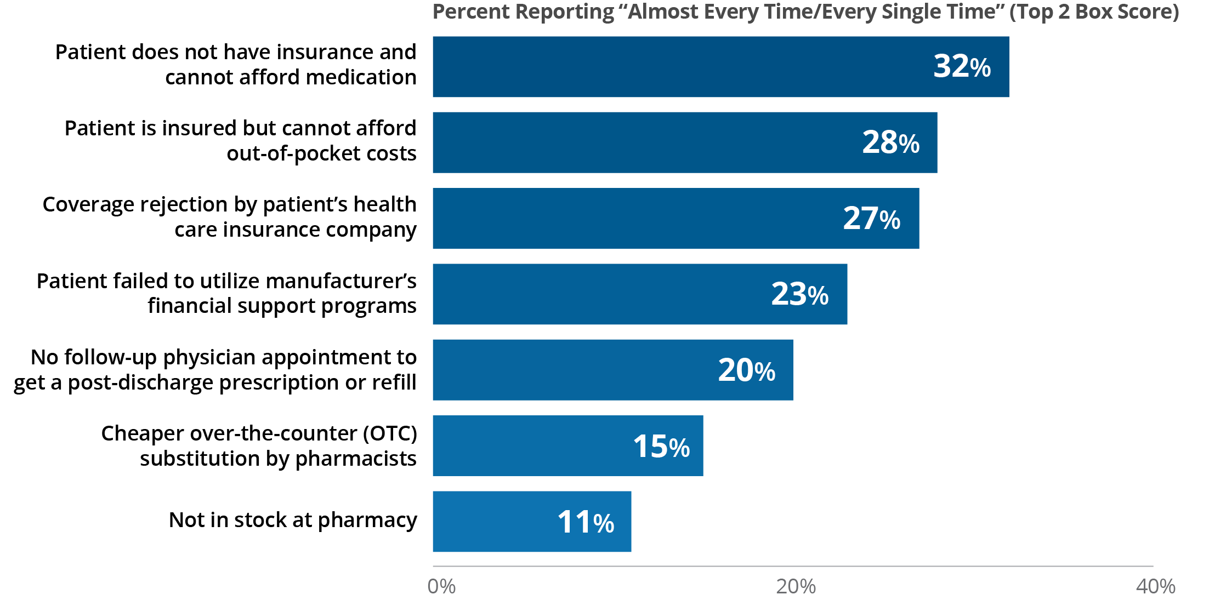
Figure 29 | Care Management | Primary Market Research via Survey
Cost-related Barriers Patients Face When Filling Prescriptions Post-discharge
Q61. How often, if at all, do the following barriers prevent a patient from filling their prescriptions post-discharge from the hospital for a liver disease–related condition? Please use the following 5-point scale, where 1=never and 5=every single time.
32% of all survey respondents report that the inability to pay for medication post hospital discharge happens the most frequently (almost every time/every single time).
N=400 (100 Gastroenterologists, 100 Hospital-based Specialists, 100 PCPs, 100 NPs/PAs).
Notes:
Figure 29 | Cost-related Barriers Patients Face When Filling Prescriptions Post-discharge
Primary Market Research via Survey
Thirty-two percent of respondents report that the inability to pay for medication post hospital discharge happens the most frequently (almost every time/every single time).

Slide 35
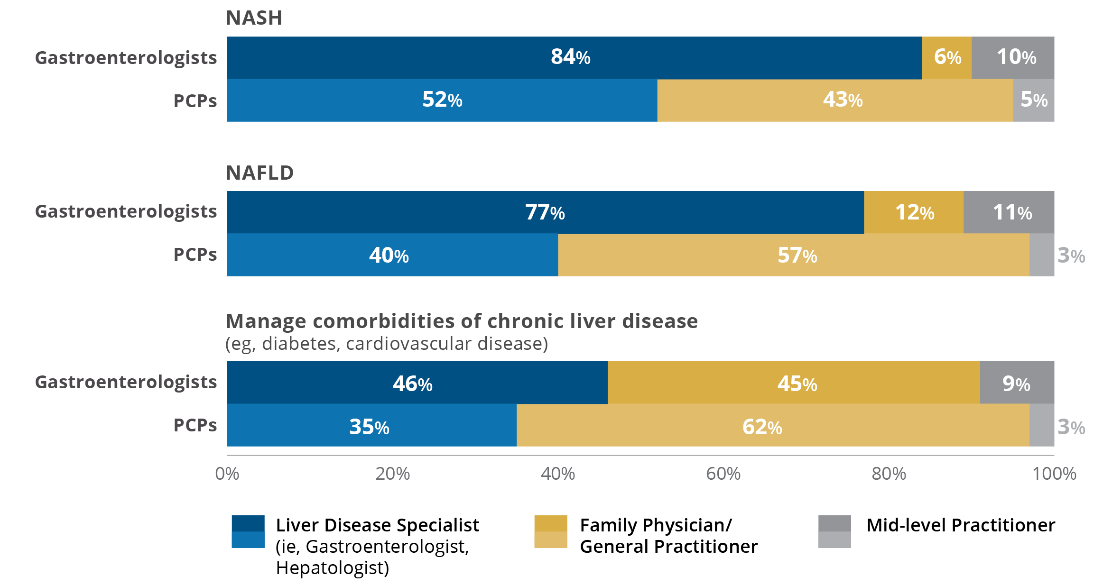
Figure 30 | Care Management | Primary Market Research via Survey
Providers’ Perceptions on Ideal Provider to Manage Early-stage Liver Disease
Q52a. Based on your personal experience, which provider type is best equipped to manage and follow (for disease progression) the following liver disease patients?
Gastroenterologists and PCPs do not agree on who is best equipped to manage NAFLD:
77% of gastroenterologists report that a liver disease specialist is the best provider.
57% of PCPs believe that family physicians/general practitioners are the most appropriate provider.
N=200 (100 Gastroenterologists, 100 PCPs).
Notes:
Figure 30 | Providers’ Perceptions on Ideal Provider to Manage Early-stage Liver Disease
Primary Market Research via Survey
Fifty-seven percent of PCPs believe that family physicians/general practitioners are the most appropriate provider.
Gastroenterologists and PCPs do not agree on who is best equipped to manage NAFLD:
77% of gastroenterologists report that a liver disease specialist is the best provider.
57% of PCPs believe that family physicians/general practitioners are the most appropriate provider.

Slide 36
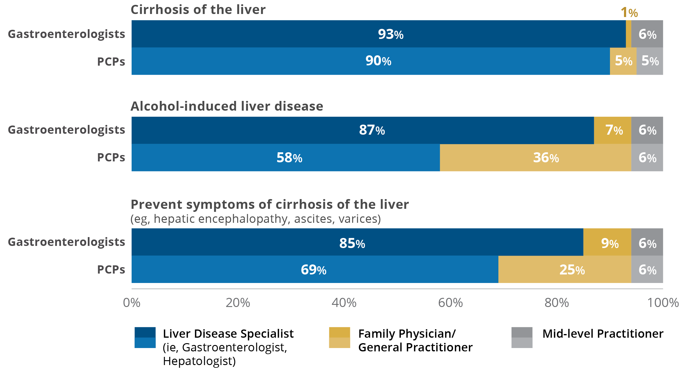
Figure 31 | Care Management | Primary Market Research via Survey
Providers’ Perceptions on Ideal Provider to Manage Advanced Liver Disease
Q52b. Based on your personal experience, which provider type is best equipped to manage (and follow for disease progression) the following liver disease patients?
≥85% of gastroenterologists feel that the specialist (hepatologist and/or gastroenterologist) is best equipped to manage patients with advancing liver disease.
PCPs agree that overall, specialists are best suited to manage this advanced patient population but see a role for themselves managing alcohol-related liver disease and in preventing symptoms of cirrhosis.
N=200 (100 Gastroenterologists, 100 PCPs).
Notes:
Figure 31 | Providers’ Perceptions on Ideal Provider to Manage Advanced Liver Disease
Primary Market Research via Survey
Gastroenterologists and PCPs were asked to report on the provider type that they feel is best equipped to manage and follow more complex liver disease patients (eg, alcohol-associated liver disease) as well as preventing the complications (symptoms) of cirrhosis (eg, ascites, HE).
≥85% of gastroenterologists feel that the specialist (hepatologist and/or gastroenterologist) is best equipped to manage patients with advancing liver disease.
PCPs agree that overall, specialists are best suited to manage this advanced patient population but see a role for themselves managing alcohol-related liver disease and in preventing symptoms of cirrhosis.

Slide 37
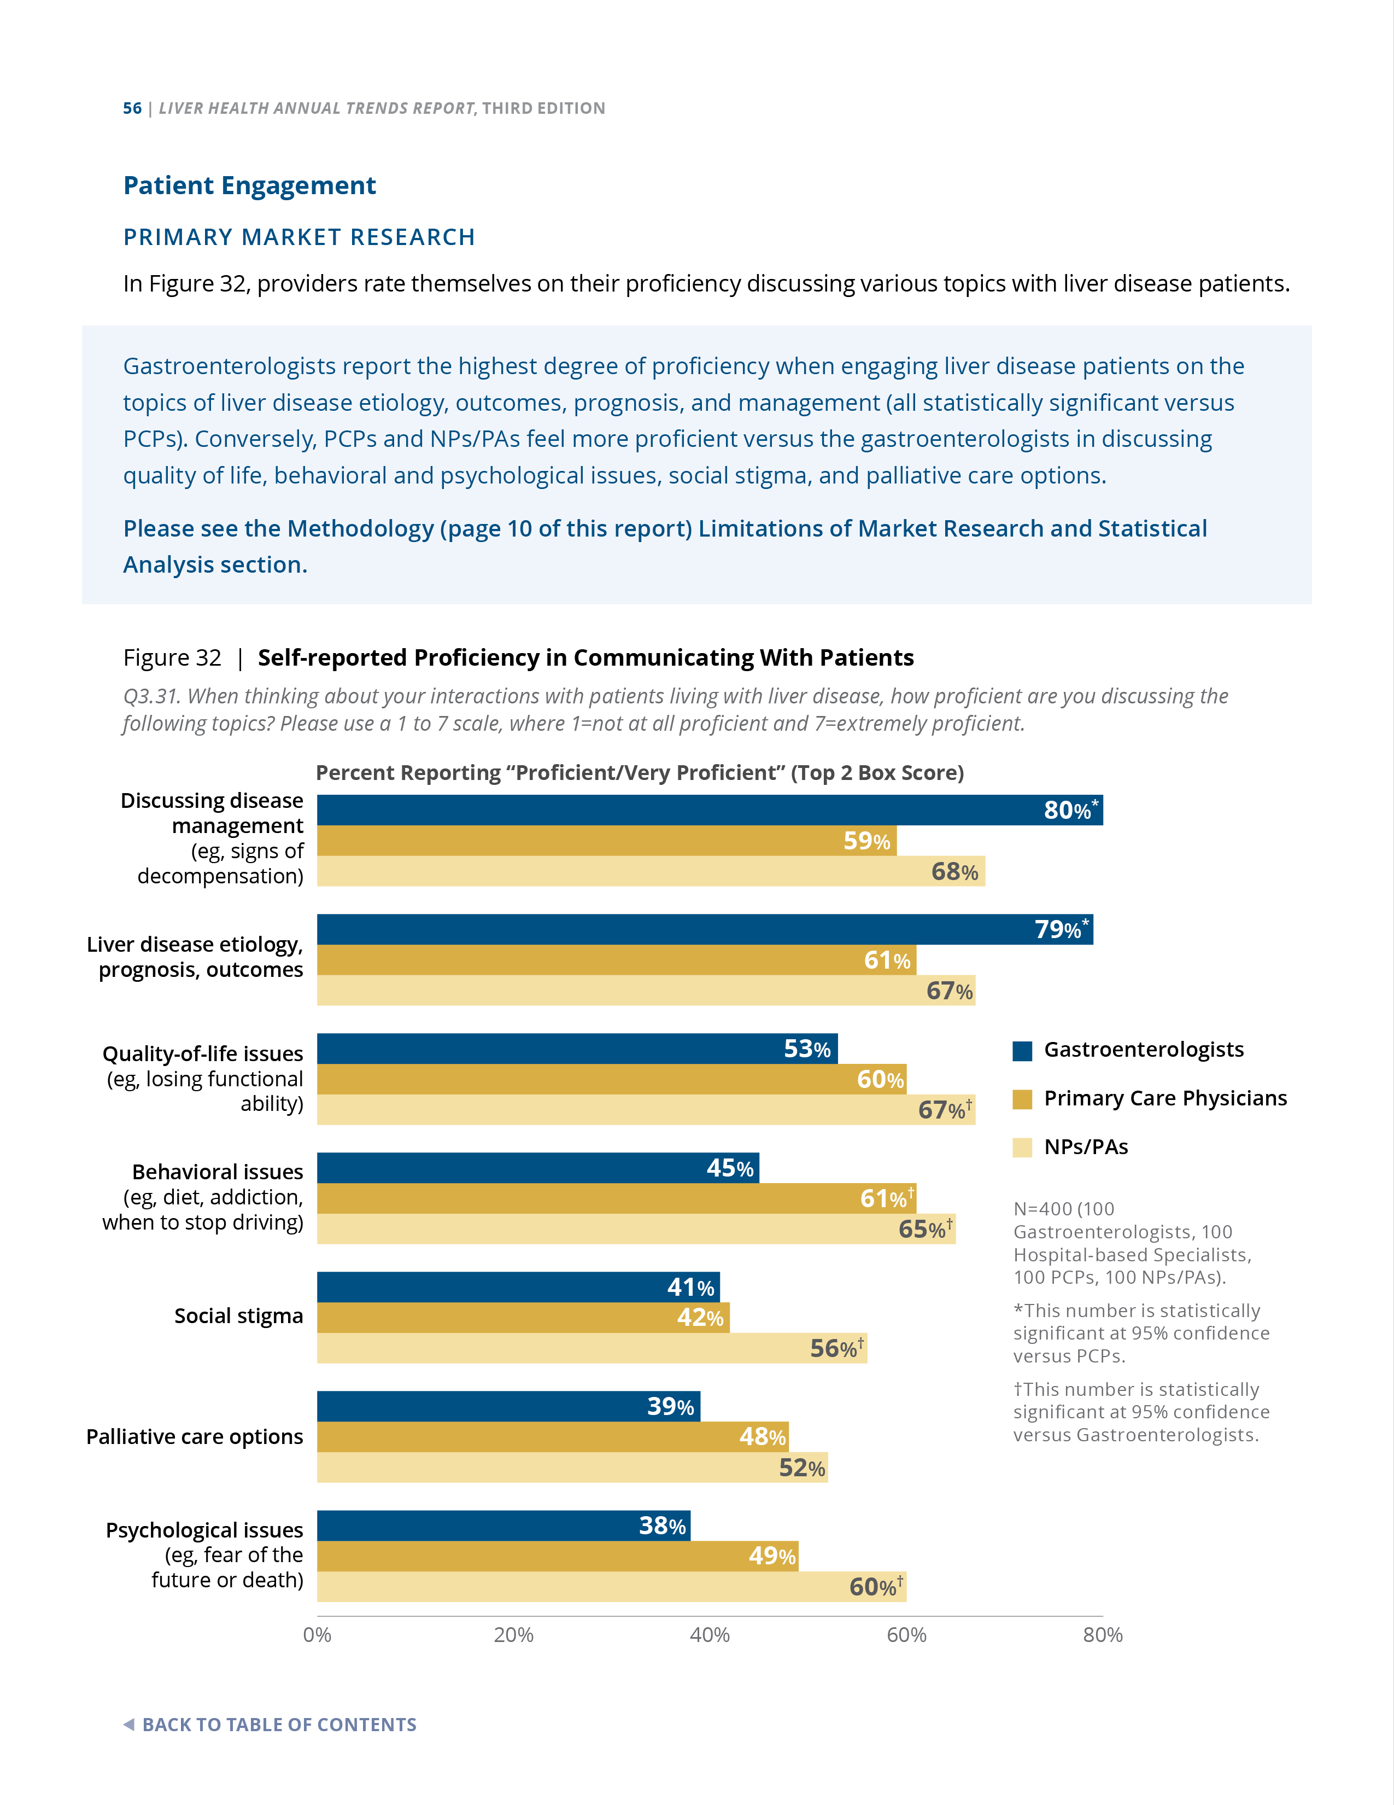
Figure 32 | Care Management | Primary Market Research via Survey
Self-reported Proficiency in Communicating With Patients
Q3.31. When thinking about your interactions with patients living with liver disease, how proficient are you discussing the following topics? Please use a 1 to 7 scale, where 1=not at all proficient and 7=extremely proficient.
Gastroenterologists report the highest degree of proficiency when engaging liver disease patients on the topics of liver disease etiology, outcomes, prognosis,
and management (all statistically significant versus PCPs). Conversely, PCPs and NPs/PAs feel more proficient versus the gastroenterologists in discussing quality of life, behavioral and psychological issues, social stigma, and palliative care options.
N=400 (100 Gastroenterologists, 100 Hospital-based Specialists, 100 PCPs, 100 NPs/PAs).
*This number is statistically significant at 95% confidence versus PCPs.
†This number is statistically significant at 95% confidence versus Gastroenterologists.
Notes:
Figure 32 | Self-reported Proficiency in Communicating With Patients
Primary Market Research via Survey
Providers rate themselves on their proficiency discussing various topics with liver disease patients.
Gastroenterologists report the highest degree of proficiency when engaging liver disease patients on the topics of liver disease etiology, outcomes, prognosis, and management (all statistically significant versus PCPs). Conversely, PCPs and NPs/PAs feel more proficient versus the gastroenterologists in discussing quality of life, behavioral and psychological issues, social stigma, and palliative care options.

Slide 38
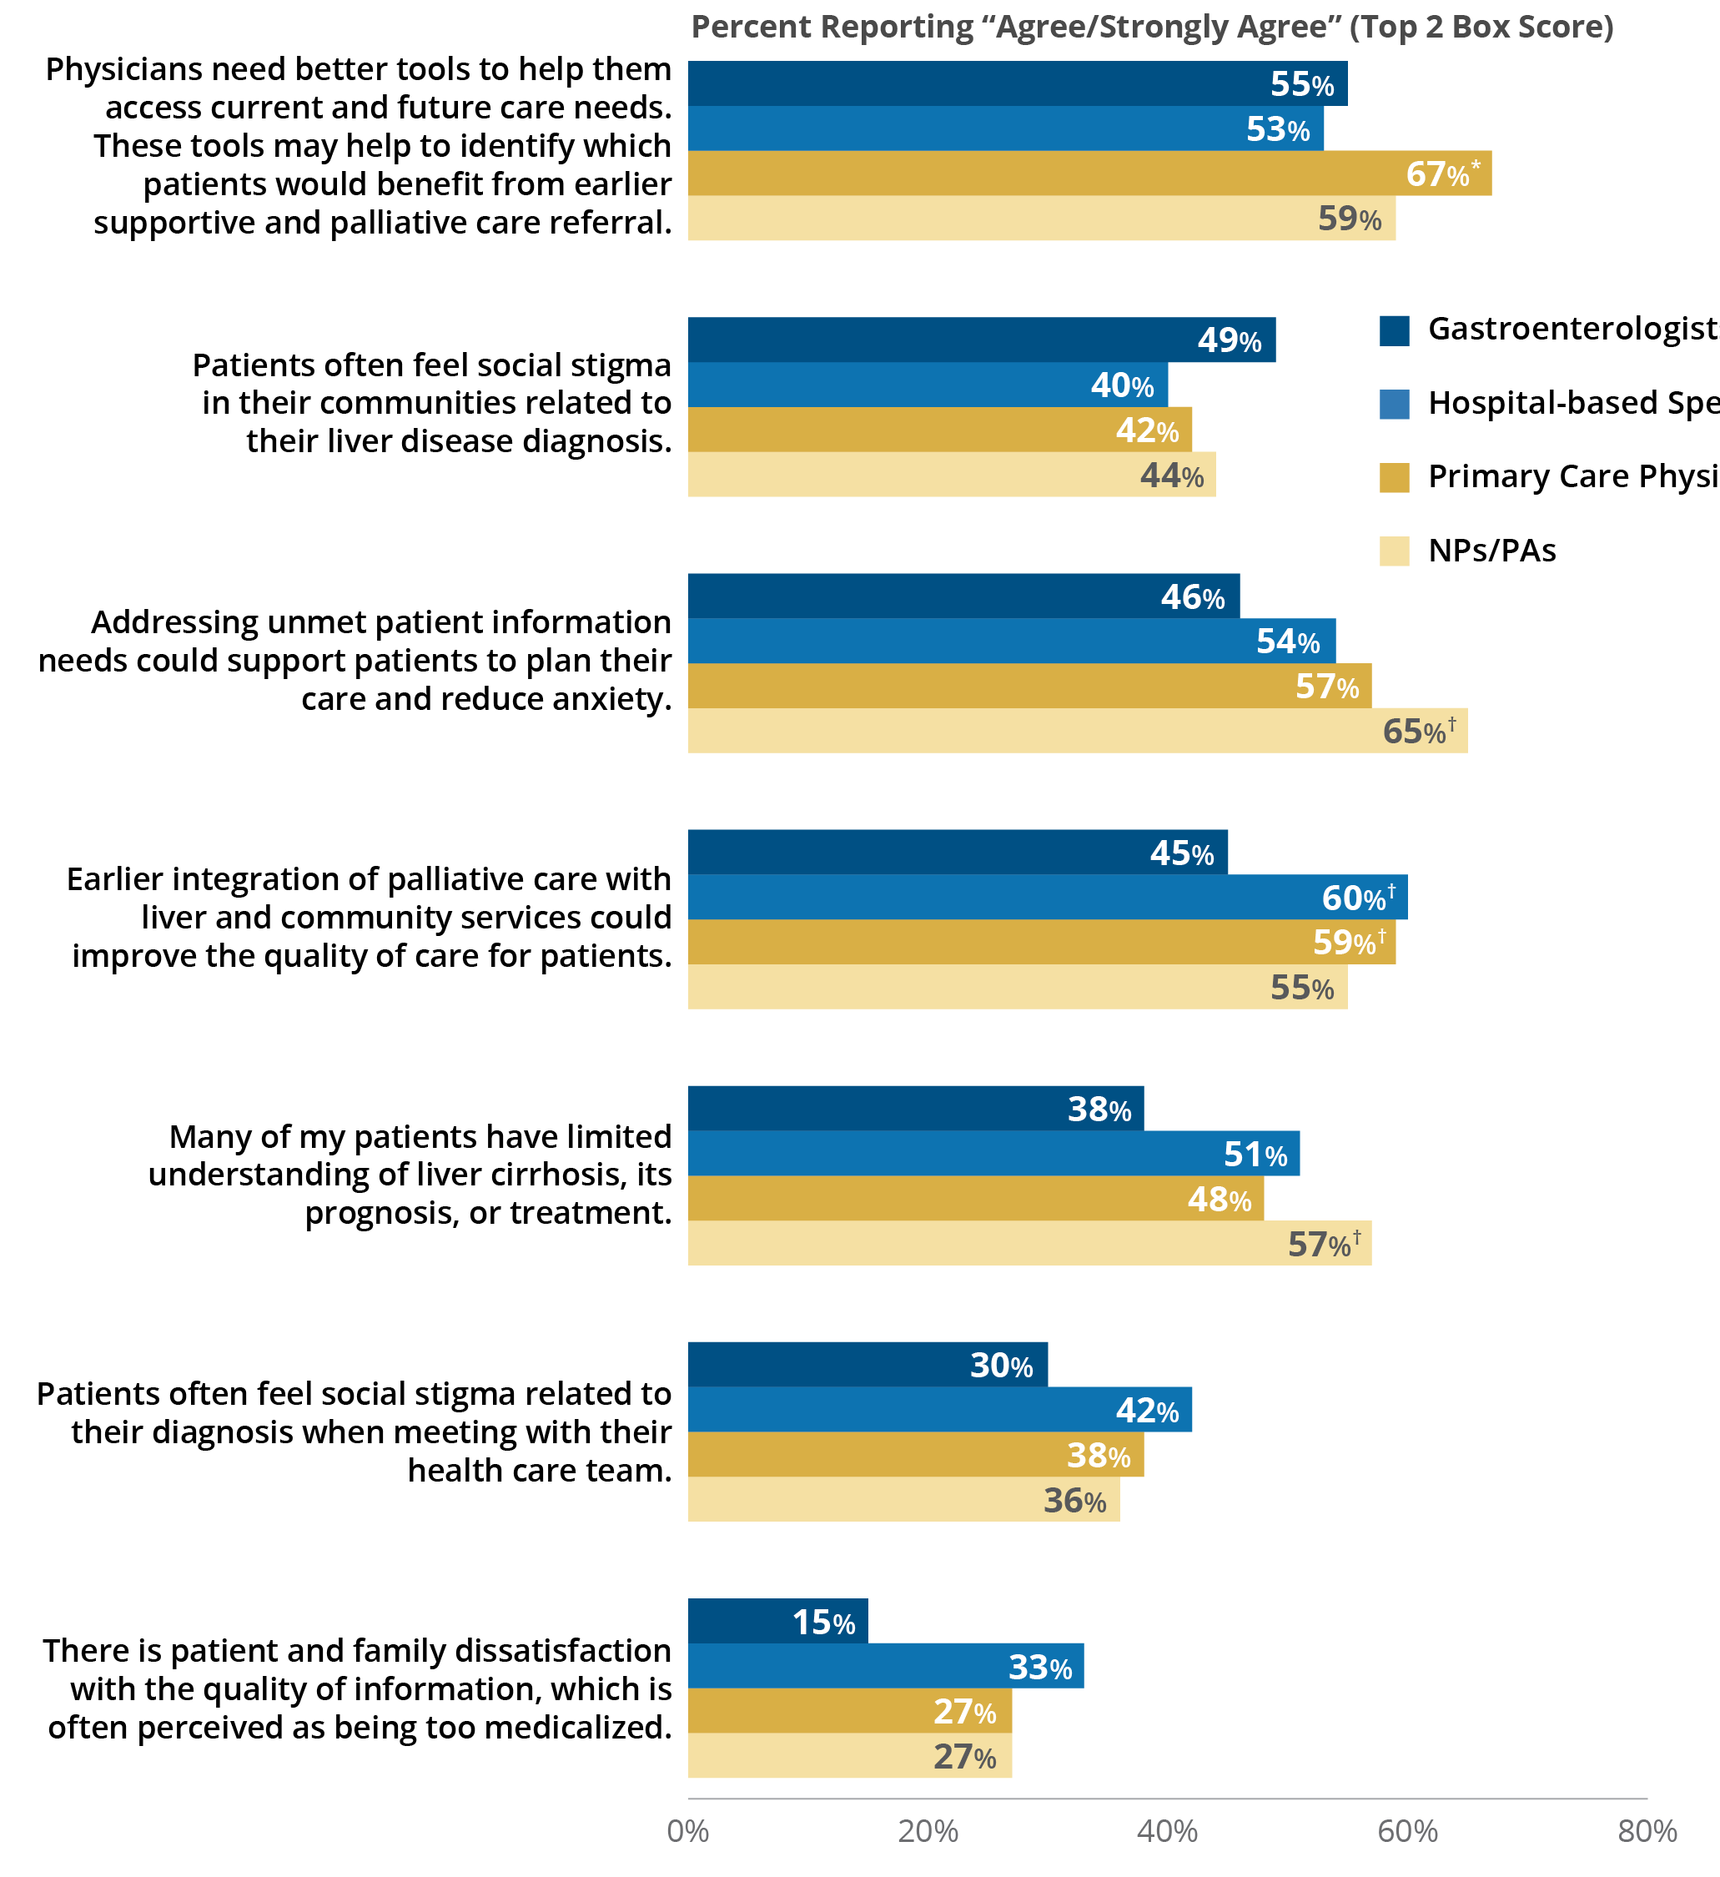
Figure 33 | Care Management | Primary Market Research via Survey
Respondent Agreement on Liver Disease Patients’ Unmet Needs
Q3.30. Please indicate your agreement with the following statements as each pertains to your patients who are living with advanced liver disease. Please use a 7-point scale, where 1=do not agree at all and 7=strongly agree.
≥55% of respondents indicated strong agreement with the need for:
Better tools to help them access current and future care needs (59%)
Addressing unmet patient information needs to help improve patient engagement in care management and reduce anxiety (56%)
Earlier integration of palliative care and community services (55%)
N=400 (100 Gastroenterologists, 100 Hospital-based Specialists,
100 PCPs, 100 NPs/PAs).
*This number is statistically significant at 95% confidence versus Hospital-based Specialists.
†This number is statistically significant at 95% confidence versus Gastroenterologists.
Notes:
Figure 33 | Respondent Agreement on Liver Disease Patients’ Unmet Needs
Primary Market Research via Survey
Figure 33 expresses the degree of provider agreement with the various statements that pertain to patients living with liver disease.
Forty-four percent of respondents agree/strongly agree with the statement that “Patients often feel social stigma in their communities related to their liver disease.” Many patients feel stigma due to misconceptions about how their liver disease occurred (eg, not knowing that it is not all alcohol related).
Thirty-seven percent of respondents agree/strongly agree with the statement that “Patients often feel social stigma related to their diagnosis when meeting with their health care team.” In telephone interviews, respondents suggested ways the medical community can reduce medical stigma (eg, stop using the terminology “fatty liver disease” but instead use NASH or NAFLD).
≥55% of respondents indicated strong agreement with the need for:
Better tools to help them access current and future care needs (59%)
Addressing unmet patient information needs to help improve patient engagement in care management and reduce anxiety (56%)
Earlier integration of palliative care and community services (55%)

Slide 39
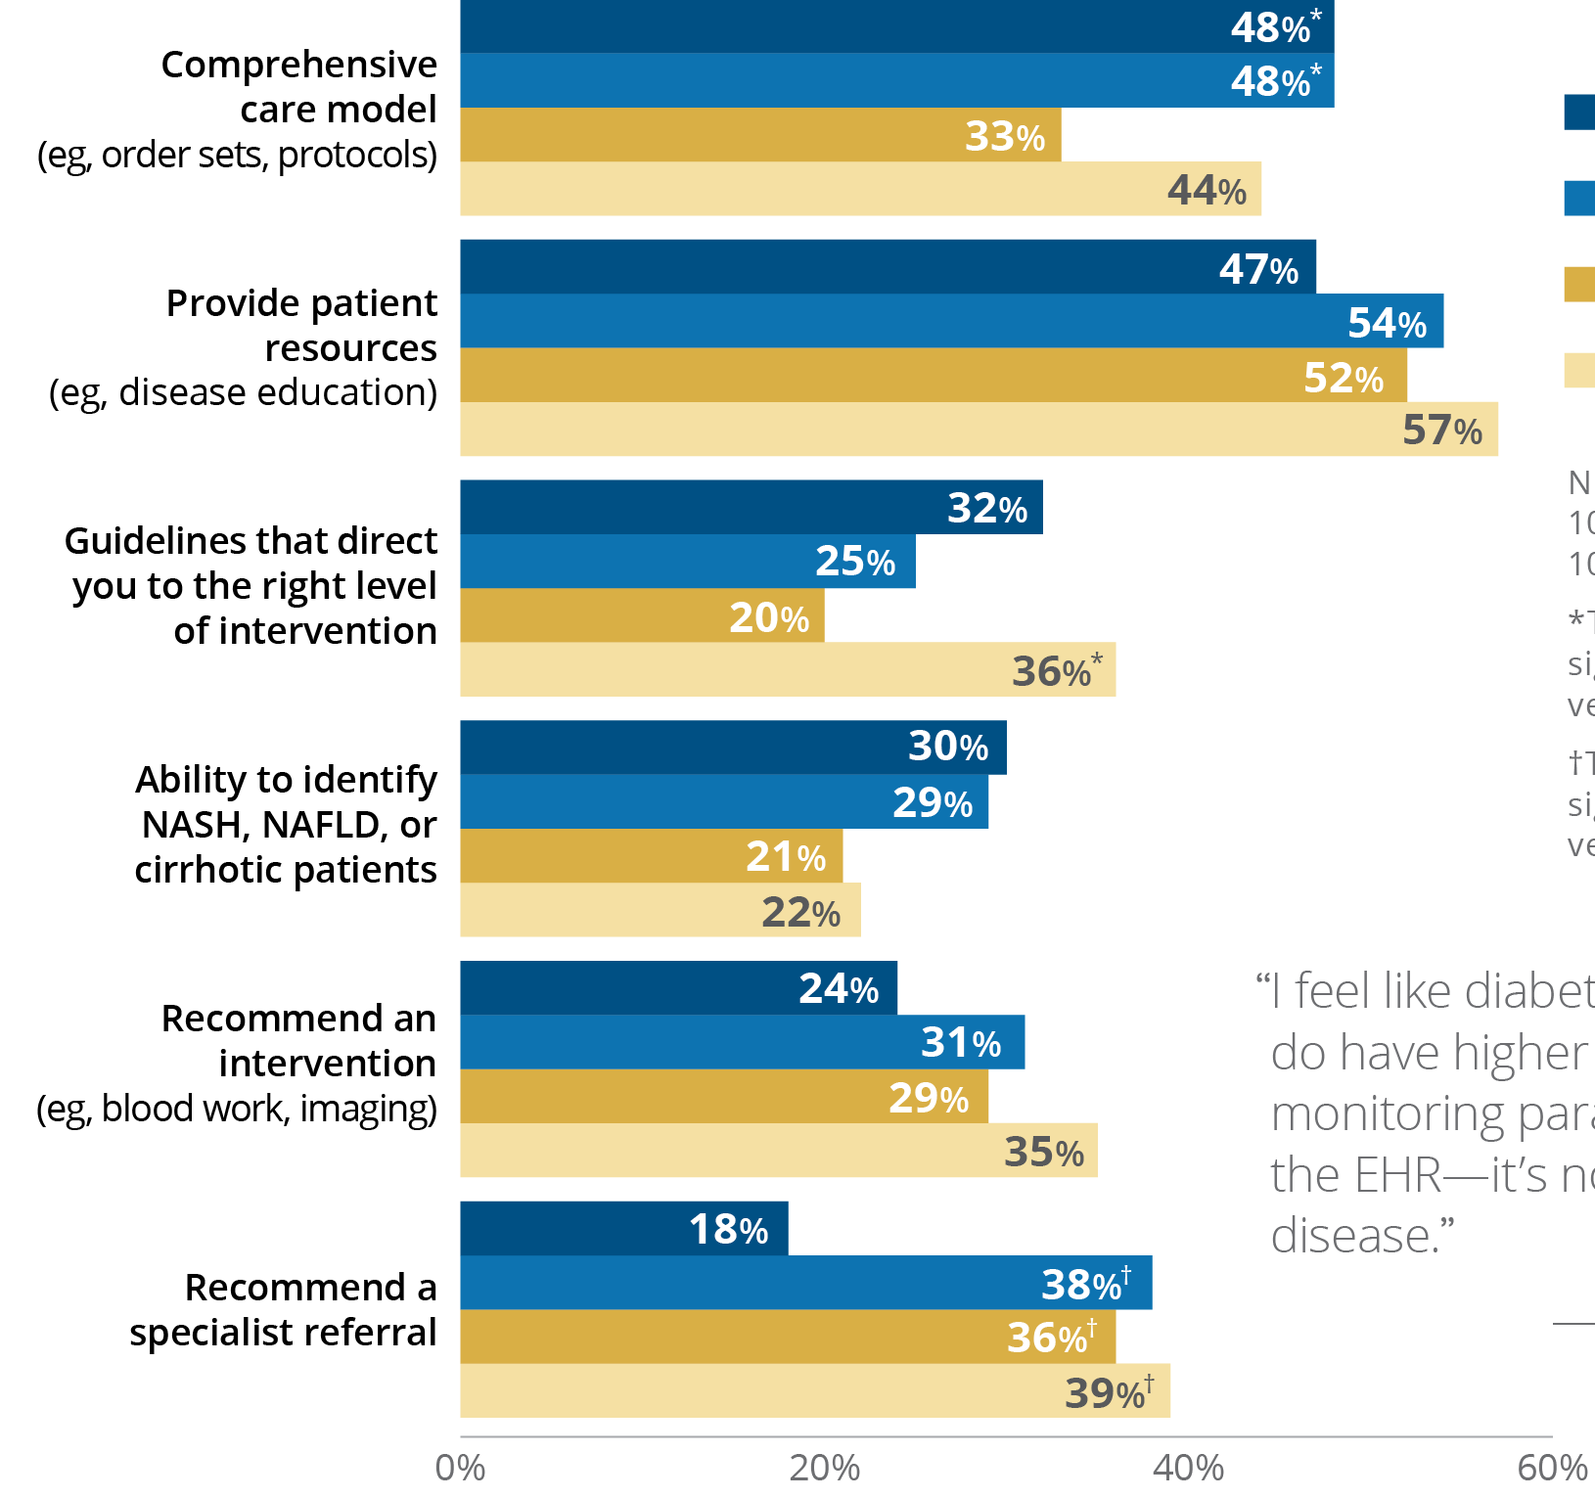
Figure 34 | Resources | Primary Market Research via Survey
EHR Information That Supports Chronic Liver Disease Patient Management
Q73. What information does your EHR system provide that helps guide your management of liver disease patients? Please select all that apply.
Tools in providers’ EHRs to help providers diagnose and manage disease progression are limited:
75% of respondents report that their EHR system does not have the ability to identify patients at risk of NAFLD/NASH or liver cirrhosis.
Only 28% of respondents reported that their EHR system contained liver disease guidelines that directed them to the right level of intervention.
43% of respondents report comprehensive care models exist for liver disease (eg, order sets, protocols) in their EHR systems. Of note, respondents coming from urban/suburban areas were more likely to have this feature than rural respondents (a statistically significant difference of 46% versus 23%, respectively).
53% of respondents report that their EHR system contains liver disease patient education resources.
N=400 (100 Gastroenterologists, 100 Hospital-based Specialists, 100 PCPs, 100 NPs/PAs).
*This number is statistically significant at 95% confidence versus PCPs.
†This number is statistically significant at 95% confidence versus Gastroenterologists.
Notes:
Figure 34 | EHR Information That Supports Chronic Liver Disease Patient Management
Primary Market Research via Survey
Figure 34 shows the types of information respondents’ EHR systems might provide that help to guide respondents’ management of their liver disease patients.
Tools in providers’ EHRs to help providers diagnose and manage disease progression are limited:
75% of respondents report that their EHR system does not have the ability to identify patients at risk of NAFLD/NASH or liver cirrhosis.
Only 28% of respondents reported that their EHR system contained liver disease guidelines that directed them to the right level of intervention.
43% of respondents report comprehensive care models exist for liver disease (eg, order sets, protocols) in their EHR systems. Of note, respondents coming from urban/suburban areas were more likely to have this feature than rural respondents (a statistically significant difference of 46% versus 23%, respectively).
53% of respondents report that their EHR system contains liver disease patient education resources.
Survey data and telephone interviews pointed to disparities in care for patients in rural versus urban/suburban locations. For example:
Less protocols/guidelines for liver disease embedded in their EHR

Slide 40
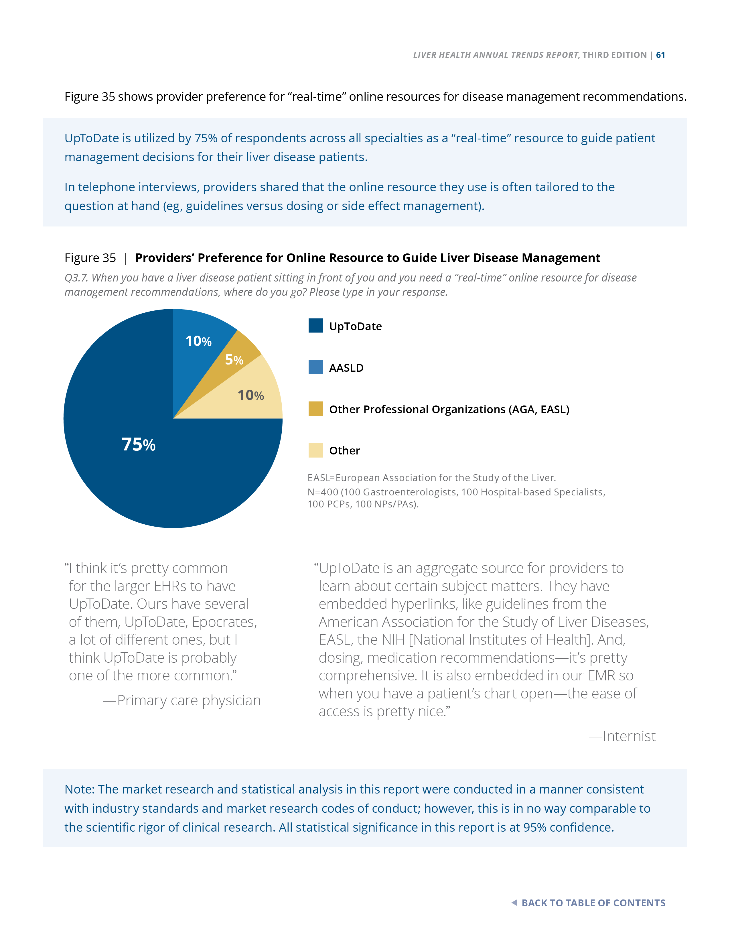
Figure 35 | Resources | Primary Market Research via Survey
Providers’ Preference for Online Resource to Guide Liver Disease Management
Q3.7. When you have a liver disease patient sitting in front of you and you need a “real-time” online resource for disease management recommendations, where do you go? Please type in your response.
UpToDate is utilized by 75% of respondents across all specialties as a “real-time” resource to guide patient management decisions for their liver disease patients.
In telephone interviews, providers shared that the online resource they use is often tailored to the question at hand (eg, guidelines versus dosing or side effect management).
AGA=American Gastroenterological Association; EASL=European Association for the Study of the Liver.
N=400 (100 Gastroenterologists, 100 Hospital-based Specialists,
100 PCPs, 100 NPs/PAs).
Notes:
Figure 35 | Providers’ Preference for Online Resource to Guide Liver Disease Management
Primary Market Research via Survey
UpToDate is utilized by 75% of respondents across all specialties as a “real-time” resource to guide patient management decisions for their liver disease patients.
In telephone interviews, providers shared that the online resource they use is often tailored to the question at hand (eg, guidelines versus dosing or side effect management).

Slide 41
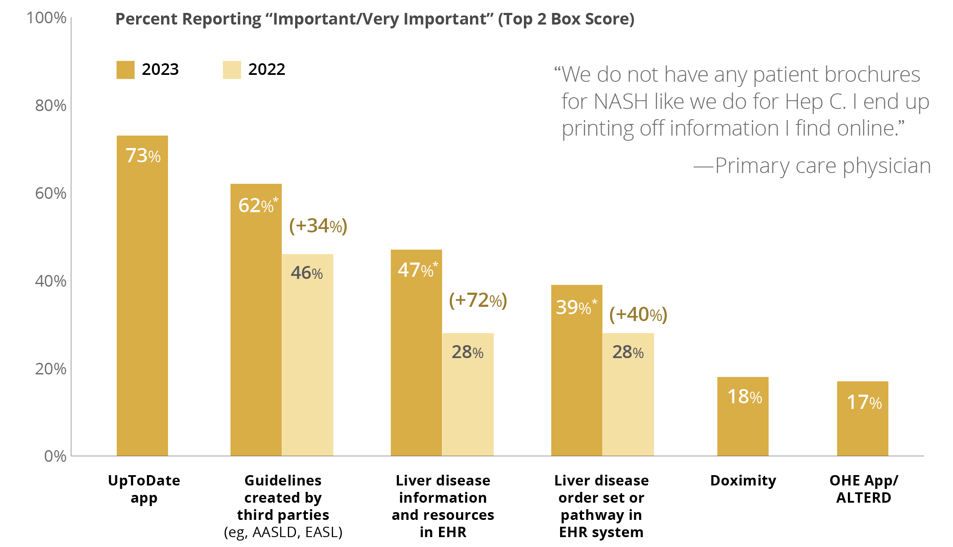
Figure 36 | Resources | Primary Market Research via Survey
Resources That Support Liver Disease Patient Management
Q62. Please rate the importance of the following resources in their ability to support liver disease patient management. Please use a 7-point scale, where 1=not at all important and 7=very important.
Respondents had statistically significant increases in their importance ratings for several of their liver disease resources:
+34% Guidelines created by third parties
+72% Liver disease information and resources in the EHR
+40% Liver disease order set or pathway in the EHR system
N=400 (100 Gastroenterologists, 100 Hospital-based Specialists, 100 PCPs, 100 NPs/PAs).
*This number is statistically significant at 95% confidence versus last year.
Values in parentheses indicate percent change from 2022.
Notes:
Figure 36 | Resources That Support Liver Disease Patient Management
Primary Market Research via Survey
Respondents had statistically significant increases in their importance ratings versus last year for several of their liver disease resources:
+34% Guidelines created by third parties
+72% Liver disease information and resources in the EHR
+40% Liver disease order set or pathway in the EHR system

Slide 42
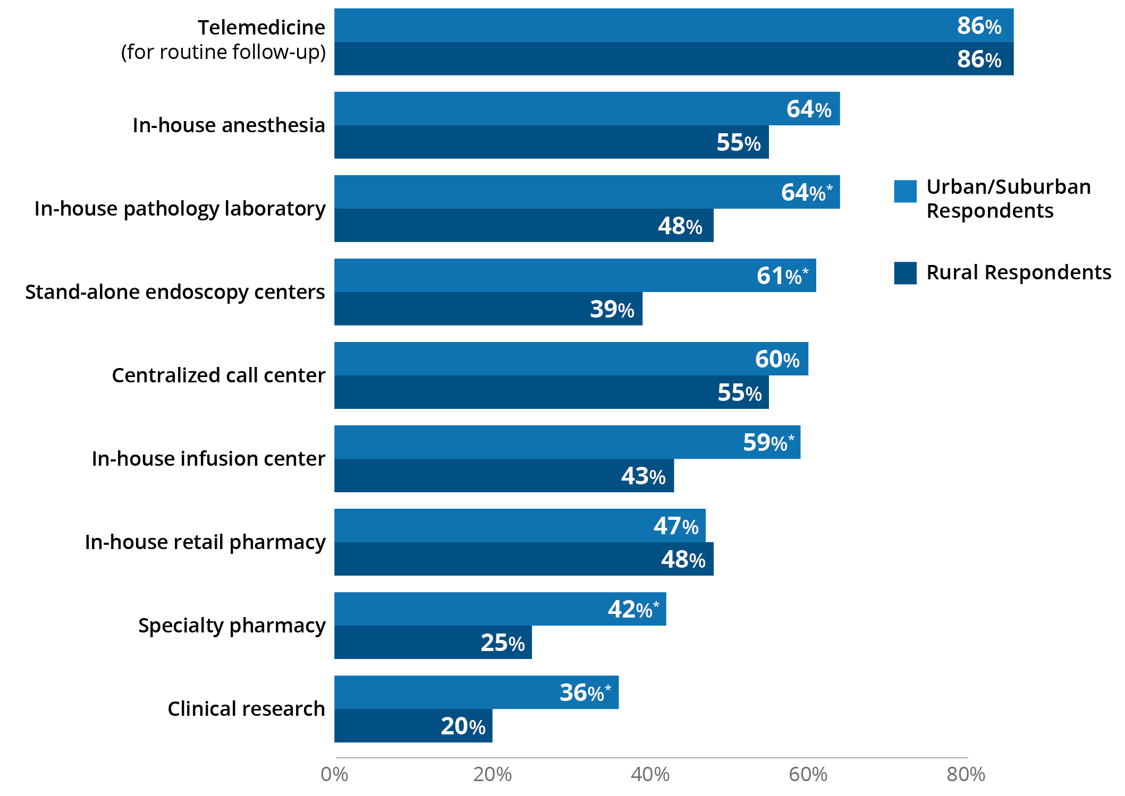
Figure 37 | Resources | Primary Market Research via Survey
Ancillary Services Available at Urban/Suburban Versus Rural Locations
Q3.26. Considering all of your organization’s sites of care, do your or other sites offer the following ancillary services to patients?
Ancillary services are generally less available to respondents in rural settings, and in many cases, statistically significant differences occurred as compared to urban/suburban respondents (ie, fewer in-house pathology labs, stand-alone endoscopy centers, in-house infusion centers, specialty pharmacies, and clinical research).
N=400 (356 Suburban/Urban-based Providers, 44 Rural-based Providers).
*This number is statistically significant at 95% confidence versus rural-based providers.
Notes:
Figure 37 | Ancillary Services Available at Urban/Suburban Versus Rural Locations
Primary Market Research via Survey
Reduced access to ancillary services (eg, clinical research)
Ancillary services are generally less available to respondents in rural settings, and in many cases, statistically significant differences occurred as compared to urban/suburban respondents (ie, fewer in-house pathology labs, stand-alone endoscopy centers, in-house infusion centers, specialty pharmacies, and clinical research).

Slide 43
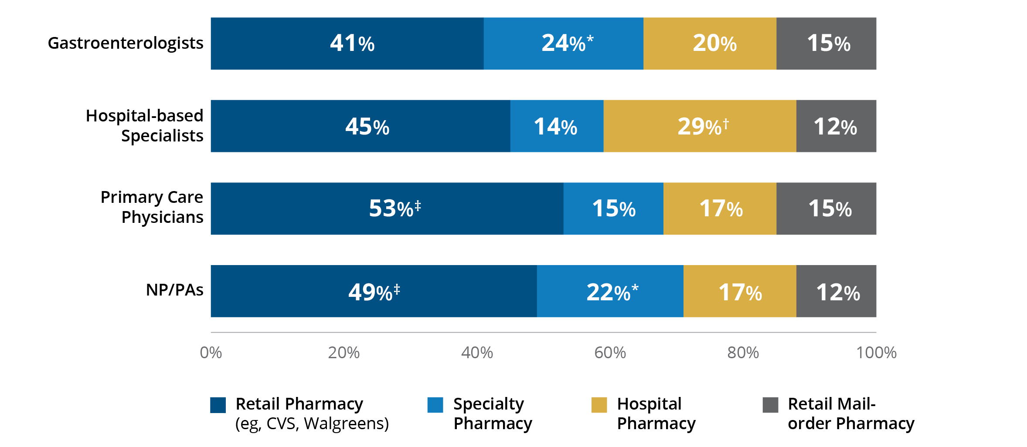
Figure 38 | Resources | Primary Market Research via Survey
Types of Pharmacies Used by CLD Patients
Q56. What percent of your prescriptions for chronic liver disease medications are sent to the following locations?
60% of respondents report their patients with CLD utilize retail pharmacies (including retail mail order).
In telephone interviews, respondents said that in some cases, specialty pharmacy organizations were helpful in minimizing the administrative burden (eg, prior authorizations) or that they hoped their use would translate into a better patient experience.
N=400 (100 Gastroenterologists, 100 Hospital-based Specialists, 100 PCPs, 100 NPs/PAs).
*This number is statistically significant at 95% confidence versus Hospital-based Specialists and PCPs.
†This number is statistically significant at 95% confidence versus all others.
‡This number is statistically significant at 95% confidence versus Gastroenterologists.
Notes:
Figure 38 | Types of Pharmacies Used by CLD Patients
Primary Market Research via Survey
Figure 38 shows the types of pharmacies used by CLD patients.
60% of respondents report their patients with CLD utilize retail pharmacies (including retail mail order).
In telephone interviews, respondents said that in some cases, specialty pharmacy organizations were helpful in minimizing the administrative burden (eg, prior authorizations) or that they hoped their use would translate into a better patient experience.

Slide 44
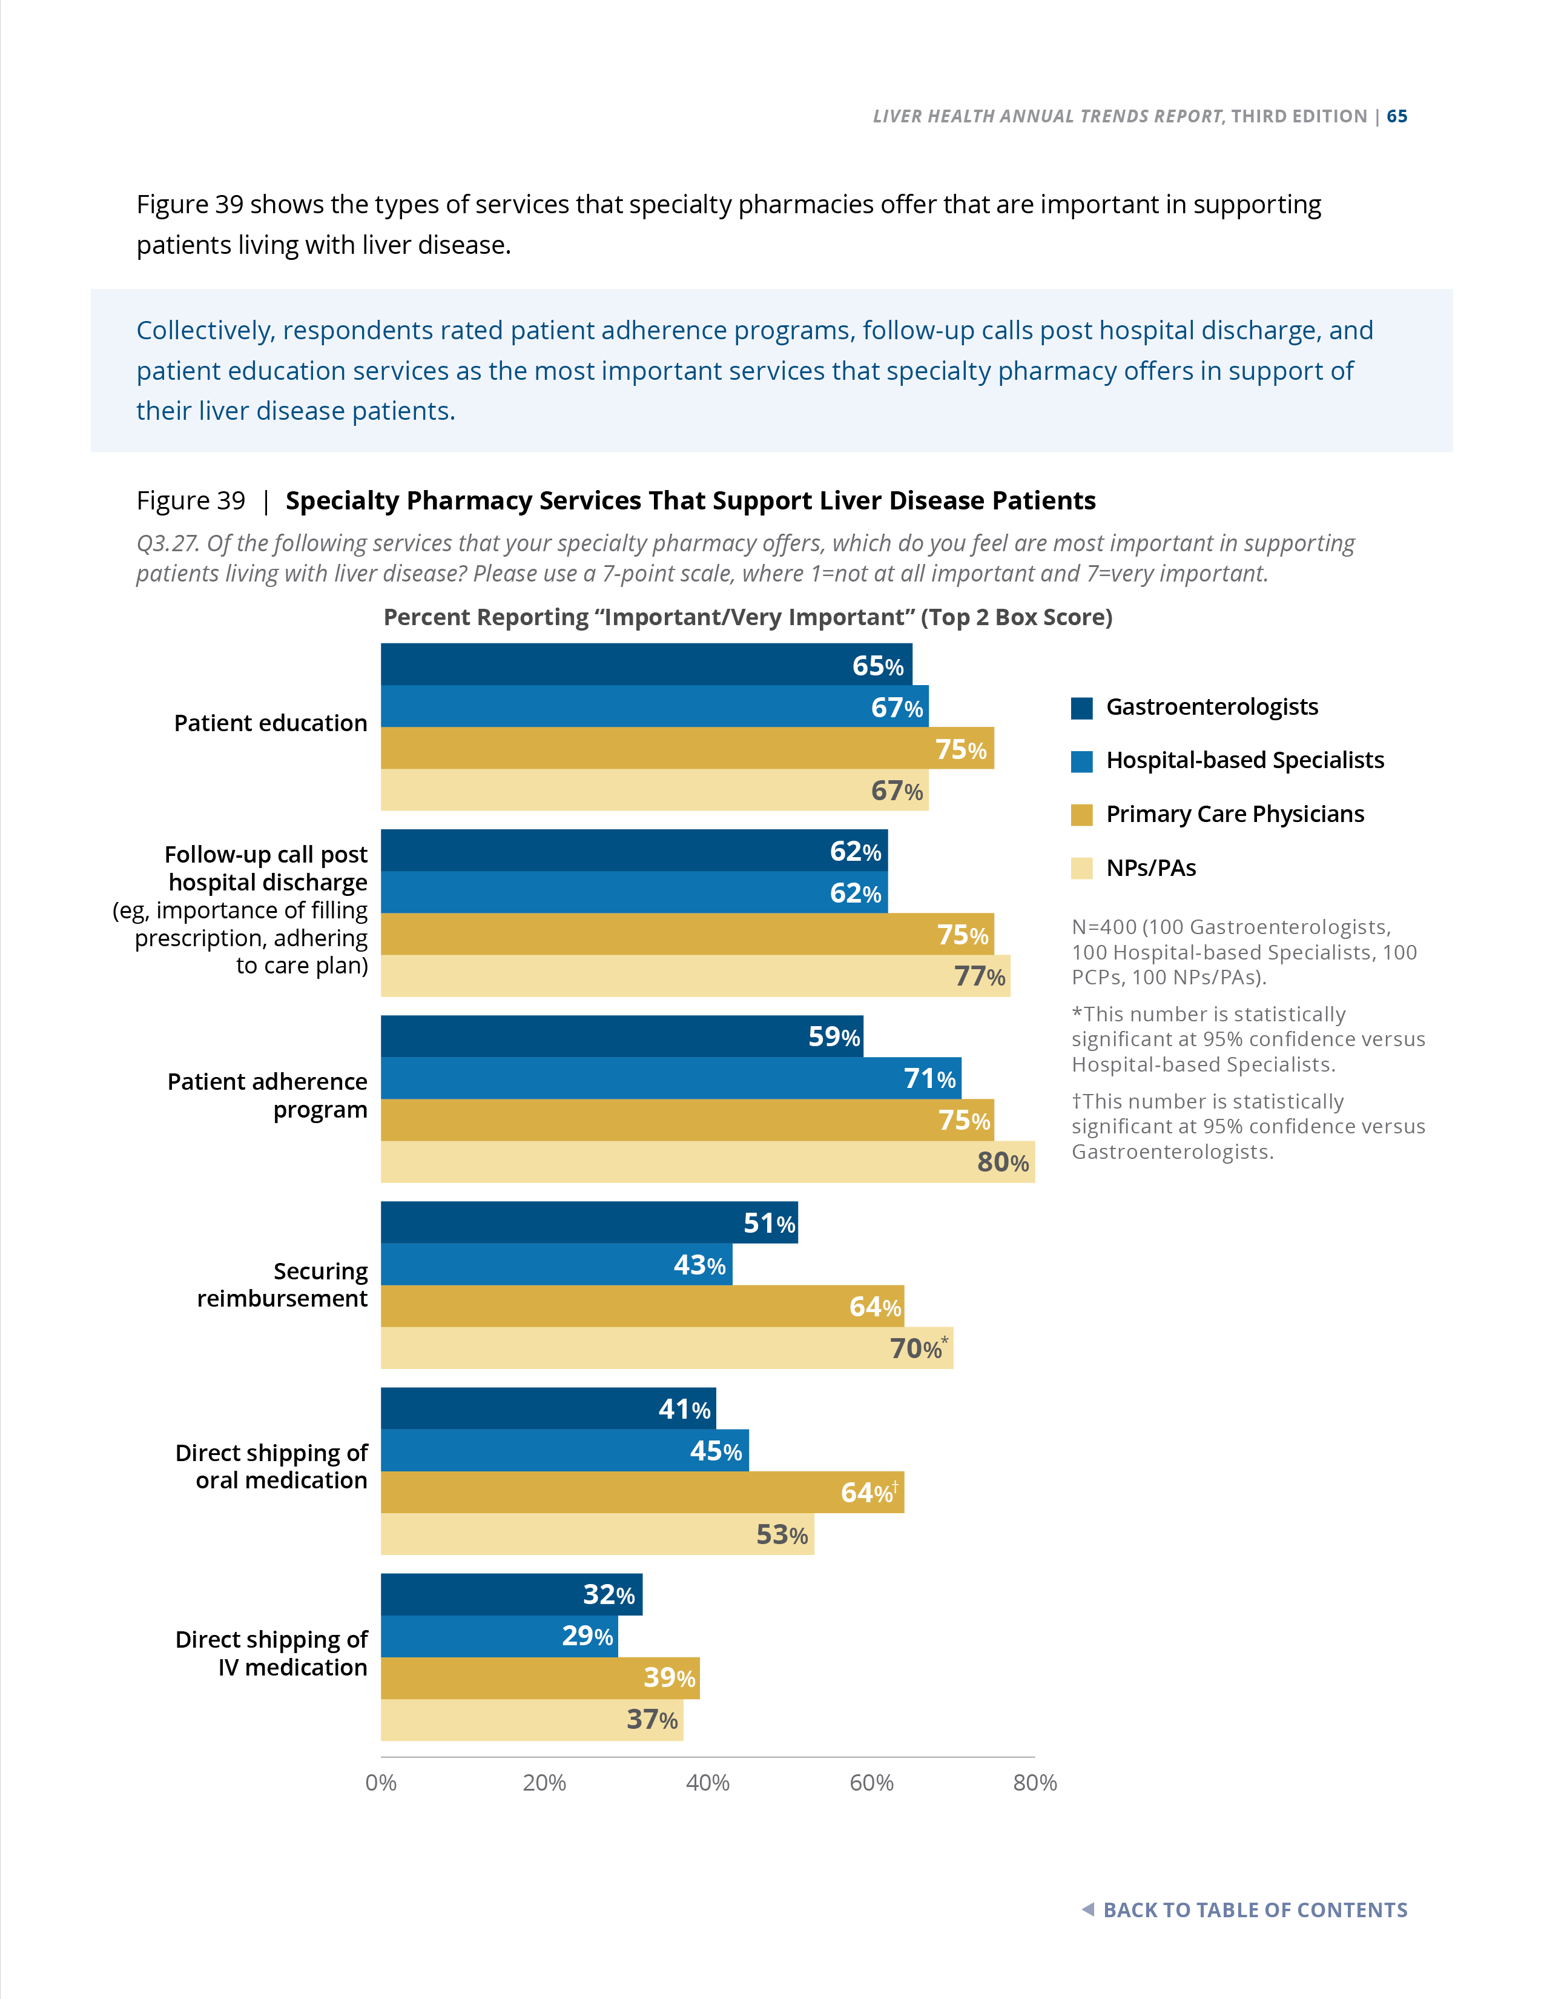
Figure 39 | Resources | Primary Market Research via Survey
Specialty Pharmacy Services That Support Liver Disease Patients
Q3.27. Of the following services that your specialty pharmacy offers, which do you feel are most important in supporting patients living with liver disease? Please use a 7-point scale, where 1=not at all important and 7=very important.
Collectively, respondents rated patient adherence programs, follow-up calls post hospital discharge, and patient education services as the most important services that specialty pharmacy offers in support of their liver disease patients.
N=400 (100 Gastroenterologists, 100 Hospital-based Specialists, 100 PCPs, 100 NPs/PAs).
*This number is statistically significant at 95% confidence versus Hospital-based Specialists.
†This number is statistically significant at 95% confidence versus Gastroenterologists.
Notes:
Figure 39 | Specialty Pharmacy Services That Support Liver Disease Patients
Primary Market Research via Survey
Figure 39 shows the types of services that specialty pharmacies offer that are important in supporting patients living with liver disease.
Collectively, respondents rated patient adherence programs, follow-up calls post hospital discharge, and patient education services as the most important services that specialty pharmacy offers in support of their liver disease patients.

Slide 45
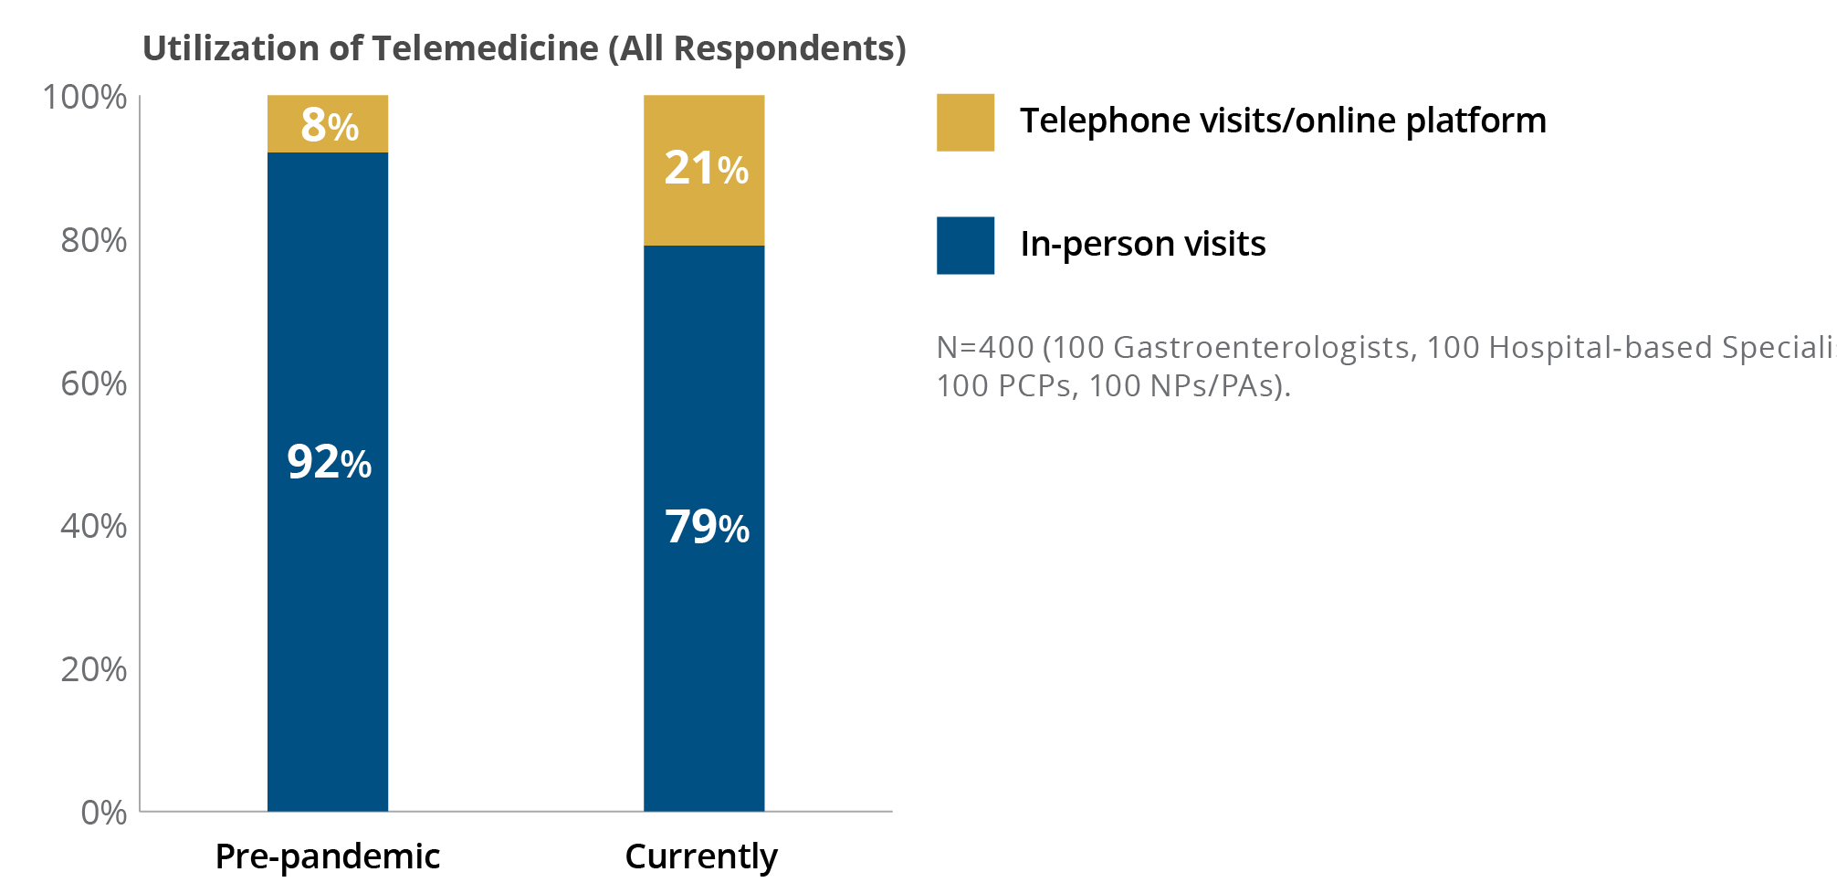
Figure 40 | Resources | Primary Market Research via Survey
Utilization of Telemedicine—Pre-pandemic Versus Current Utilization
Q3.28.1 What percent of all your liver patients’ routine office visits (that do not require a physical exam) are delivered by the following means?
Utilization of telemedicine remains higher than
pre-pandemic levels (21% versus 8%, respectively).
In telephone interviews, respondents stated that the pandemic accelerated their adoption of telemedicine.
N=400 (100 Gastroenterologists, 100 Hospital-based Specialists, 100 PCPs, 100 NPs/PAs).
Notes:
Figure 40 | Utilization of Telemedicine—Pre-pandemic Versus Current Utilization
Primary Market Research via Survey
Figure 40 shows that utilization of telemedicine remains higher than pre-pandemic levels (21% versus 8%, respectively).
Utilization of telemedicine remains higher than pre-pandemic levels (21% versus 8%, respectively).
In telephone interviews, respondents stated that the pandemic accelerated their adoption of telemedicine.

Slide 46
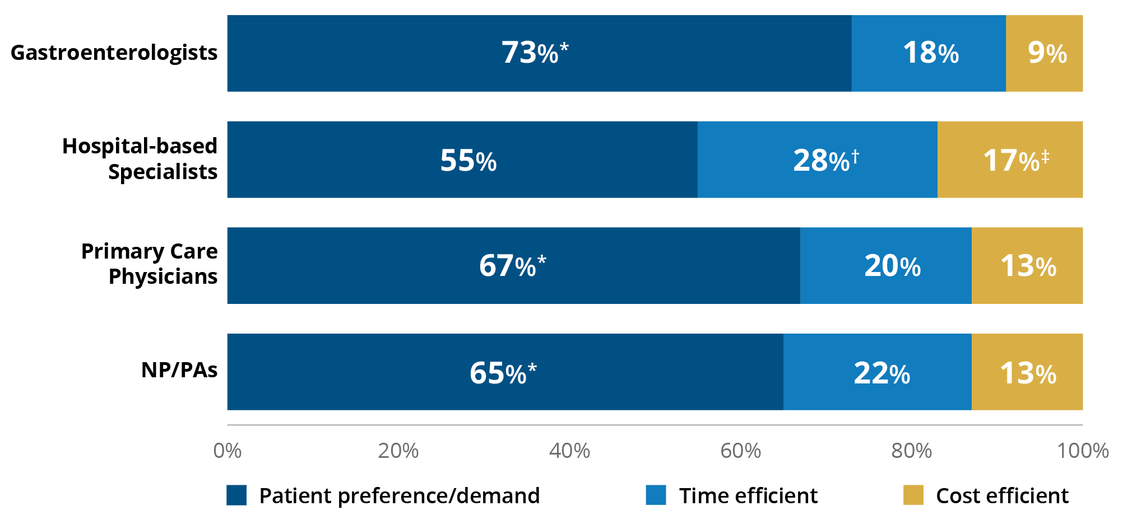
Figure 41 | Resources | Primary Market Research via Survey
Drivers of Telemedicine Utilization for Routine Patient Visits
Q3.29. Why are you using telemedicine for routine patient visits?
N=400 (100 Gastroenterologists, 100 Hospital-based Specialists, 100 PCPs, 100 NPs/PAs).
*This number is statistically significant at 95% confidence versus Hospital-based Specialists.
†This number is statistically significant at 95% confidence versus PCPs and Gastroenterologists.
‡This number is statistically significant at 95% confidence versus Gastroenterologists.
Patient demand and preference are driving telemedicine use.
In the telephone interviews, providers shared that they will continue to offer telemedicine as long as it is reimbursed.
Notes:
Figure 41 | Drivers of Telemedicine Utilization for Routine Patient Visits
Primary Market Research via Survey
Respondents were asked to report on the reasons for the utilization of telemedicine for routine patient visits.
Patient demand and preference are driving telemedicine use.
In the telephone interviews, providers shared that they will continue to offer telemedicine as long as it is reimbursed.

Slide 47
Review the complete third edition of the
Liver Health Annual Trends Report at
.com/trends-report
Salix Pharmaceuticals: 400 Somerset Corporate Blvd., Bridgewater, NJ 08807
© 2023 Salix Pharmaceuticals or its affiliates. HED.0107.USA.23
Notes:
[Read slide.]

